Slide 1
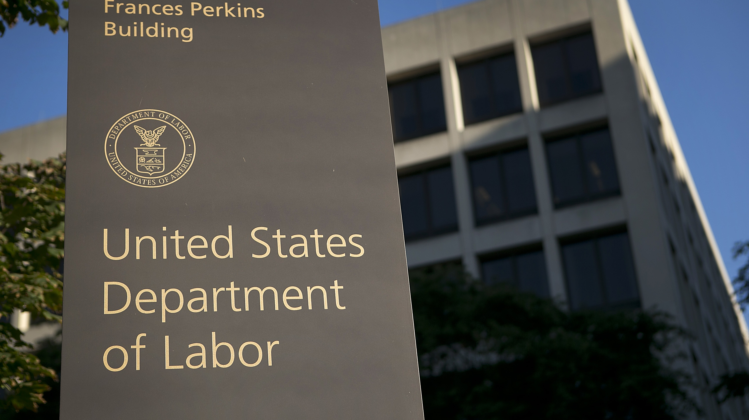

National Trends in Employment Law
Barbara L. Johnson, Esq. May 10, 2017

Slide 2




Introduction
Trump administration is pushing to deregulate at federal level
Federal level: Uncertainty Over Future of Dodd-Frank, DOL overtime rule, EEOC equal pay data rule, and many Obama-era NLRB decisions
  Supreme Court: Validity of class action waivers; sexual orientation discrimination under Title VII?
State level: pay equity, parental leave, medical marijuana, minimum wage, and predictable scheduling

Slide 3

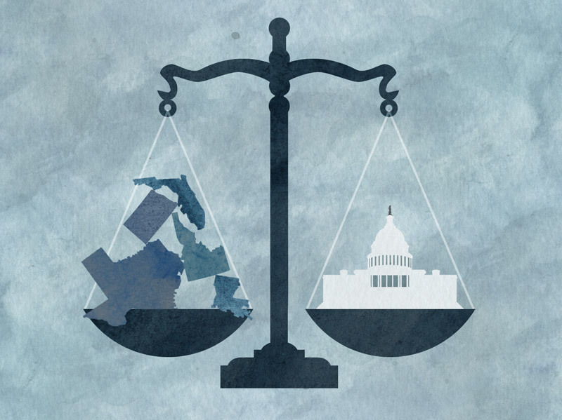
State Employment Laws Addressing Areas Historically
Covered by Federal Employment Laws
Federal employment laws
  Title VII
  FLSA
  ADA
  Family Medical Leave Act
State employment laws
Notes:
Even if you decide that your company would like to maintain its drug-free, zero-tolerance policy, it is still important to be aware of the interaction of medical marijuana laws and certain state employment laws.

Slide 4
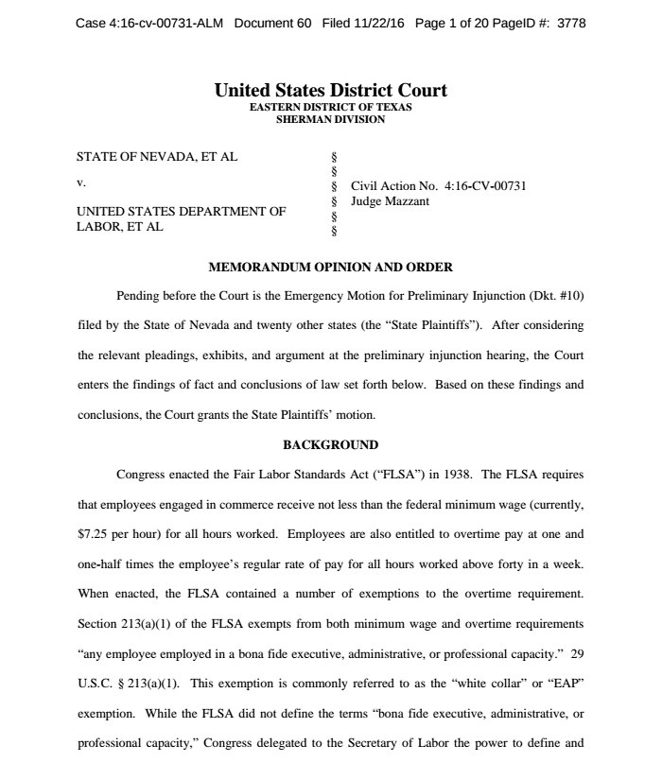
Obama’s Overtime Rule Enjoined
Would greatly expand overtime eligibility and double the minimum salary threshold required to qualify for white collar overtime exemption under FLSA
Enjoined in Nov. 2016 by Texas District Court, finding that DOL may lack statutory authority to raise threshold as much as it did
  Nevada v. DOL
Trump administration could withdraw rule and allow injunction to become permanent; has signaled it may raise exempt salary level to a lower, more modest threshold

Slide 5

Wage & Hour Class Actions
For 2016, number of filings decreased while value of settlements increased (strong incentive for employers to settle)
Number of filings projected to rise again in 2017, due to a high certification rate relative to other employment law class actions
Several recent plaintiff-friendly Supreme Court decisions may make it easier for them to advance as well

Slide 6
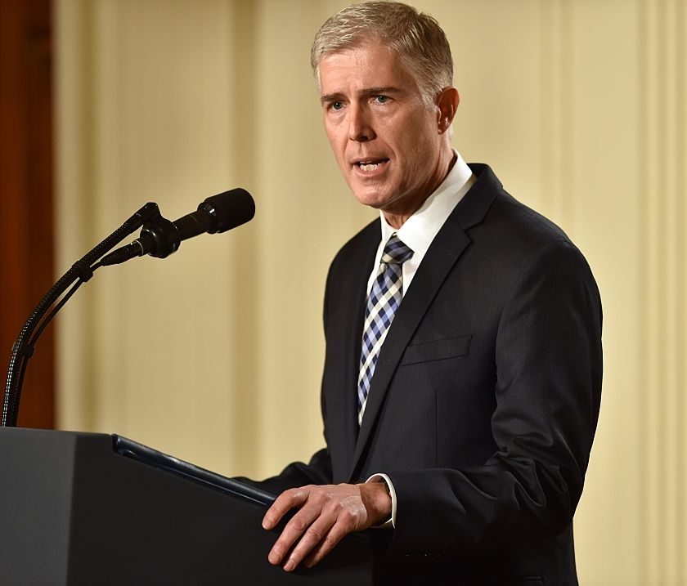
Class Action Waivers
Supreme Court will hear and consider whether arbitration agreements with class action waivers infringe on substantial federal rights of employees and thus violate NLRA
  Circuit split between Seventh and Ninth Circuits (are unenforceable) and Fifth Circuit (do not violate federal law)
  Newly-confirmed Justice Gorsuch likely will be the deciding vote

Slide 7
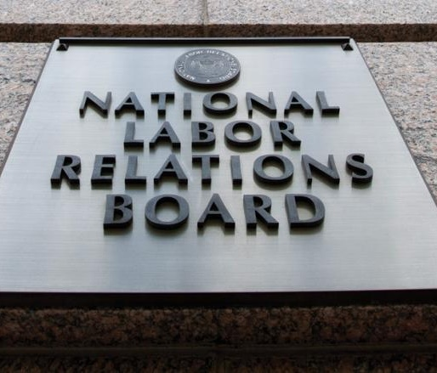
Joint Employment Test & Future of the NLRB
Speculation that Trump’s NLRB nominees will try to roll back key Obama-era labor decisions
  Focus primarily on revised joint-employer standard under Browning-Ferris, which expanded standard to include “indirect control” and opened up franchisors to potential joint employer liability
NLRB also facing hostility from congressional Republicans, who are pressuring Board to move in employer-friendly direction

Slide 8
Charges Filed With The EEOC
Retaliation: 42,018 (45.9 percent of all charges filed)
Race: 32,309 (35.3 percent)
Disability: 28,073 (30.7 percent)
Sex: 26,934 (29.4 percent)
Age: 20,857 (22.8 percent)
National Origin: 9,840 (10.8 percent)
Religion: 3,825 (4.2 percent)
Color: 3,102 (3.4 percent)
Equal Pay Act: 1,075 (1.2 percent)
Genetic Information Non-Discrimination Act: 238 (.3 percent)
Notes:
Earlier this month, the United States Court of Appeals for the Eleventh Circuit affirmed in part and vacated and remanded in part the district court’s decision in Evans v. Georgia Regional Hospital, holding that Title VII of the Civil Rights Act of 1964 (“Title VII”) does not prohibit sexual orientation discrimination in the workplace.
Jameka Evans worked at Georgia Regional Hospital (the “Hospital”) in Atlanta, Georgia, as a security officer. Evans, who is a lesbian, had a masculine gender presentation at work: she wore the men’s security officer uniform, men’s shoes, and a short, masculine haircut. According to Evans’ complaint, the Hospital discriminated against her because of her sexual orientation and because she did not behave in a “traditional woman[ly] manner.” Evans alleged that she was denied equal pay, harassed, physically assaulted, targeted for termination, and retaliated against after making a complaint of discrimination to the Hospital’s Human Resources department.
Evans filed suit pro se in the U.S. District Court for the Southern District of Georgia, bringing a sexual orientation discrimination claim and a sex discrimination claim, the latter of which was based on the Hospital’s discrimination against her on the basis of her gender nonconformity. The district court dismissed the complaint, finding that Title VII “was not intended to cover discrimination against homosexuals” and that Evans’ sex stereotyping claim was “just another way to claim discrimination based on sexual orientation.” The court appointed counsel from Lambda Legal, who had filed an amicus brief in support of Evans, to represent Evans on appeal, and Evans appealed to the Eleventh Circuit.
In its March 10, 2017 decision, the Eleventh Circuit vacated and remanded the district court’s dismissal of Evans’ sex discrimination claim with instructions to grant Evans leave to file an amended complaint. While the Eleventh Circuit found that Evans’ complaint had not adequately shown that “her decision to present herself in a masculine manner led to the alleged adverse employment actions,” it held that “the lower court erred because a gender non-conformity claim is not ‘just another way to claim discrimination based on sexual orientation,’ but instead, constitutes a separate, distinct avenue for relief under Title VII.” Accordingly, Evans—particularly as a pro se litigant—was entitled to amend her complaint to plead additional facts in support of her sex-stereotyping gender discrimination claim.
The court next addressed Evans’ sexual orientation discrimination claim, affirming the lower court’s dismissal. While the majority opinion’s justification for the dismissal was straightforward—stating simply that binding precedent held that sexual orientation discrimination is not actionable under Title VII and thus precluded Evans from bringing the claim—Judges William Pryor and Robin Rosenbaum filed separate concurring opinions, which addressed the sexual orientation discrimination claim and Evans’ arguments in greater detail.
Pryor criticized the argument that “a person who experiences discrimination because of sexual orientation necessarily experiences discrimination for deviating from gender stereotypes.” The argument is, in other words, that discrimination on the basis of sexual orientation is at root sex discrimination because it derives from gender-based stereotypes that men should exclusively be attracted to and have relationships with women, and vice versa.
Pryor contends, however, that such an argument in fact itself “relies on false stereotypes of gay individuals” by assuming that “all gay individuals necessarily engage in the same behavior.” Pryor argues that this characterization of sexual orientation discrimination—i.e., as discrimination based on gender-based stereotypes about “correct” romantic and sexual attraction—is problematic: “By assuming that all gay individuals behave the same way or have the same interests,” it “disregard[s] the diversity of experiences of gay individuals.” That is, describing sexual orientation discrimination as sex discrimination presumes that all gay people have relationships with members of the same sex, which is not necessarily true; Pryor cites, for instance, gay people who “adopt … the gay ‘social identity’ but experience a variety of sexual desires,” “choose not to marry or date at all,” “choose a celibate lifestyle,” or “choose to enter mixed-orientation marriages.”
However, the argument that sexual orientation discrimination constitutes discrimination on the basis of sex is not solely based on universalizing claims about the relationship behavior of people who identify as gay. The claim that gay people do not conform to gender-based stereotypes need not be based on assumptions about the types of sexual and romantic relationships they have. In her opinion, concurring in part and dissenting in part, Rosenbaum wrote:
By definition, a gay employee is sexually attracted to members of her own sex. … So when an employer discriminates against an employee solely because she is a lesbian, the employer acts against the employee only because she is sexually attracted to women, instead of being attracted to only men, like the employer prescriptively believes women should be.
The essential similarity shared by gay people is an attraction to the same gender; it is hardly a “false stereotype” to assert that a person who openly identifies as gay experiences attraction to people of the same gender. An out lesbian engages in gender-nonconforming behavior when she is open about her attraction to women—whether she is in a relationship with another woman or not—because, in doing so, she defies the gender-based stereotype that women “should” be exclusively attracted to men. Consequently, an employer who discriminates against her does so because she does not conform to the employer’s prescriptive stereotypes about women.
Though federal law still does not prohibit sexual orientation discrimination in the workplace, LGBT employees in New York are protected by the New York State Human Rights Law and the New York City Human Rights Law. If your employer has discriminated against you on the basis of your sexual orientation, contact The Harman Firm, LLP.

Slide 9



Title VII Sexual Discrimination Litigation
Seventh Circuit, sitting en banc, found that Title VII prohibits sexual orientation discrimination (Hively v. Ivy Tech)
Circuit split with Eleventh Circuit (Evans v. Georgia Regional Hospital), making the issue ripe for Supreme Court review
Notes:
the Seventh Circuit made countless employment law casebooks obsolete by upsetting decades of largely uniform precedent — both its own and those of its sister circuits — that had held that Title VII’s prohibition on discrimination “because of ... sex” did not extend to discrimination that was specifically motivated by sexual orientation. While its opinion in Hively v. Ivy Tech Community College of Indiana, No. 15-1720, 2017 (7th Cir. Apr. 4, 2017), makes the Seventh Circuit the only appellate jurisdiction yet to have found that Title VII extends to sexual orientation, the nationwide case law on the matter was perhaps less settled than it appeared at first blush.
The idea that sexual orientation discrimination is discrimination “because of ... sex” and so within the purview of Title VII is not a new one, although it has recently gathered steam. It has a commonsense appeal. Most conceptions of discrimination based on sexual orientation involve sex stereotypes and expectations about appropriate norms and behavior for members of one’s sex, including whom one partners with or is attracted to. Such discrimination punishes perceived deviations from a traditional gendered model: this is what a man is, and this is what men do; this is what a woman is, and this is what women do. Under that model, a man is supposed to act like a man, and pair with women; a woman is supposed to act like a woman, and pair with men.
From this vantage point, the decision has its roots in Price Waterhouse v. Hopkins, 490 U.S. 228 (1989), which endorsed a sex-stereotyping theory of sex discrimination. There, an employer had criticized Hopkins for being too “masculine” and not “feminine” enough, including: not wearing makeup or jewelry or dressing “femininely”; using foul language; needing “charm school”; and being “tough-talking,” “hard-nosed” and “aggressive.” Id. at 235. The trial judge held that these and other similar remarks “stemmed from an impermissibly cabined view of the proper behavior of women,” resulting in sex discrimination based on stereotyping. Id. at 236-37. The U.S. Supreme Court agreed. By definition, the court concluded: “In the specific context of sex stereotyping, an employer who acts on the basis of a belief that a woman cannot be aggressive, or that she must not be, has acted on the basis of gender.” Id. at 250 (emphasis added). The court observed that “we are beyond the day when an employer could evaluate employees by assuming or insisting that they matched the stereotype associated with their group.” Id. at 251. Ultimately it held that a plaintiff in such a case must prove that “stereotyping” — what the court characterized as a “discriminatory impulse” — “played a motivating role in an employment decision.” Id. at 252.
Likewise, an employer who acts on the basis of a belief that a woman should not be attracted to or pair with other women has also acted because of sex. As in Hopkins, behavior and characteristics that would be perfectly acceptable — even lauded — for a male employee now become disqualifying, solely because of sex. If Title VII forbids a woman being discriminated against in the workplace for being “too masculine” or “not feminine enough,” she also shouldn’t be discriminated against because her alignment towards women in matters of the heart is traditionally associated with “male” rather than “female” norms. In either case, it does not matter that the employer would accept a more stereotypically “feminine” woman; all other things being equal, the employer would have no problem with a man.
Prior to Hively and the developments leading up to it, the Hopkins sex stereotyping theory had gained some traction but typically could not be used to take on sexual orientation discrimination directly. A plaintiff might have a claim that he was discriminated against because he was seen as “feminine” or “fey,” or because she was seen as “masculine” or “butch,” but couldn’t typically claim discrimination for being or being perceived to be gay, lesbian or bisexual. Sometimes, LGB words and signals needed to be eschewed from pleadings altogether lest they taint and undermine the claim; as the original Hively panel observed, “claims tended to be successful only if [] employees could carefully cull out the gender nonconformity discrimination from the sexual orientation discrimination.” Hively v. Ivy Tech Community College 830 F.3d 698, 704-705 (7th Cir. 2016).[1] As the panel highlighted, this has led to a good deal of legal twisting and uncertainty, without a sound practical or theoretical basis for a distinction. And underpinning the tremulous edifice was the simple assumption that sexual orientation discrimination was not protected by Title VII.
It is this premise that was fundamentally flawed. Sexual orientation discrimination is sex discrimination, and it is stereotyping based on gender nonconformity, regardless of whether one is stereotypically “butch,” “femme” or anything in between. And it is equally damaging and pernicious.
A second thread that comes in here helps demonstrate why this approach was limited and lacking. In the two decades leading up to Obergefell, a number of opinions by state and federal courts in the same-sex marriage cases highlighted the sex discrimination rationale for overturning same-sex marriage bans. The logic is self-evident. A woman who wants to marry a woman, or a man who wants to marry a man, is being classified on the basis of sex; if the plaintiff’s sex were different, so too would be the result. “Sex” is the deciding variable. Conversely, the plaintiff is being discriminated against based on the sex of his or her mate — classic associational discrimination.[2]
Indeed, while believing that its hands were tied, the original panel in Hively bemoaned the “paradoxical legal landscape in which a person can be married on Saturday and then fired on Monday for just that act,” 830 F.3d at 714, and in which the law on sex discrimination protects women who wear pants or short hairstyles over those who traverse the “most essential of gender stereotypes by marrying another woman.” Id. at 715.
What is exciting here, but long overdue, is that the Seventh Circuit has recognized these commonsense concepts and applied them in the context of Title VII. It is the first appeals court to do so. It focuses on the key inquiry: What would happen if the critical variable — the plaintiff’s sex — were changed? Would she still have suffered the adverse employment action? In that light, sexual orientation discrimination (discrimination because one is attracted to, or dates or marries a same-sex rather than opposite-sex partner) is quintessential sex discrimination.
On the whole, the Hively decision is very good news for plaintiffs and potential plaintiffs who have been subjected to employment discrimination on the basis of sexual orientation. There remains, however, a great deal of uncertainty going forward, and it is inevitable that some plaintiffs will benefit more than others. These are a few takeaways we’d offer to anyone considering engaging in affirmative litigation under Title VII for sexual orientation discrimination.
Takeaways
The immediate effect of Hively is that victims of sexual orientation discrimination in the Seventh Circuit (Illinois, Indiana and Wisconsin) now have fully cognizable claims under Title VII in the same way they would if they had suffered discrimination on the basis of race or religion. These individuals now have access to the federal courts and to the U.S. Equal Employment Opportunity Commission’s administrative process that they might not have otherwise had, even under the protections they would have had under state law. While the effects will vary significantly based on individual circumstances, this turn of events will likely give plaintiffs and potential plaintiffs far greater leverage in their efforts to resolve their claims outside of outright litigation.
Plaintiffs and potential plaintiffs in other circuits should benefit considerably as well, although the effect will vary. It bodes well for victims of sexual orientation discrimination that Hively came out of the Seventh Circuit,[3] rather than circuits like the Second or Ninth that are often thought of as more progressive. Having such a decision come out of a widely influential yet relatively middle-of-the-road circuit gives clear cover to panels in other circuits to follow its lead. (And we suspect that there are more than a few judges in other circuits that may feel slightly jealous about having been beaten to the punch by the Seventh Circuit.) It is also helpful that so much press attention has gone to the concurrence by celebrity jurist Judge Richard Posner, which pulled no punches in announcing the circuit court’s obligation — and authority — to bring Title VII and its attendant case law into step with the modern world, including evolving conceptions about the rights due to LGBT people. It is likely that Hively has opened the floodgates to making Title VII available to victims of sexual orientation discrimination. It’s more likely than not that the next case heard by, for example, the Ninth Circuit that could implicate this issue will be called en banc for the purpose of updating circuit case law.
However, it’s unclear just how long the party will last. Although the defendant in Hively has announced that it doesn’t plan to petition the Supreme Court for certiorari, it is inevitable that the Supreme Court will be given enough opportunities to review this issue that it will be able to more or less pick its time — and the fact that there is now an unequivocal circuit split involving arguably the most high-profile protected class of the last two decades suggests that a grant of cert is a matter of when and not if. Whether the Supreme Court will endorse the approach adopted in Hively — or even just the outcome — is uncertain, and even more so now that Justice Neil Gorsuch has assumed a place on the court. Further, while Hively is by no means dependent on deference to the EEOC and its widely cited 2015 determination that Title VII covers sexual orientation discrimination, any interpretation based on deference to the agency could be susceptible to changes in the administration.
Perhaps the most important lesson to be learned from Hively is that our civil rights laws aren’t static, even when their codified language hasn’t changed in two generations. Good lawyering in a case like Kimberly Hively’s naturally begins with a clear-eyed assessment of what causes of action are and are not viable, but by (legislative) hook or by (judicial) crook our laws are generally revised or reinterpreted over time to more closely reflect the values of the society they govern. It falls to creative counsel like Hively’s attorneys at Lambda Legal to make sure that the courts have the opportunity and the necessary support to develop existing law to better serve the interests of justice.
Finally, the most practical way to understand Hively may be as a call for legislative action — what the majority refers to as a “belt-and-suspenders” approach. Practitioners and advocates should not rely solely on judicial interpretations modernizing (or “sunrising”) existing law. The vast majority of Americans — regardless of their religious or political affiliation — support workplace protections for LGBT individuals, and there is a powerful case to continue to be made in Congress and in jurisdictions around the country that explicit protections for sexual orientation and gender identity are long overdue. Hively is certainly not fragile, but it is vulnerable — to Congressional action, to Supreme Court reversal, and to simply being written off by other circuits. It does, however, provide both a blueprint and inspiration for action by the political branches of government.

Slide 10


Criminal Background
And Credit Checks
Barbara L. Johnson, Esq. May 12, 2017

Slide 11

State Limitations on the Hiring Process
Some states have shown interest in restricting employers from looking into an individual’s credit, criminal, or salary history during pre-employment / job application process
  MA has adopted salary history restriction; being considered in NY
  Coincides with rise of class actions filed under FCRA

Slide 12
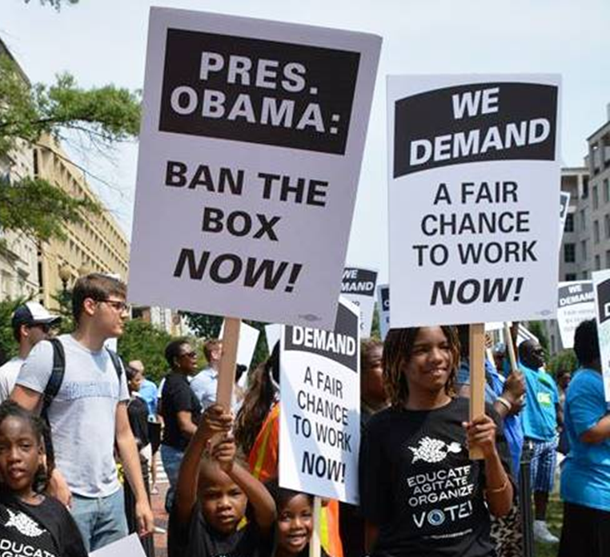
Why Is “Ban the Box” a State/Local Initiative?
States and localities have been active in this area
This area has come under scrutiny in recent years because criminal background checks often have a disparate impact on African-Americans and Hispanics

Slide 13
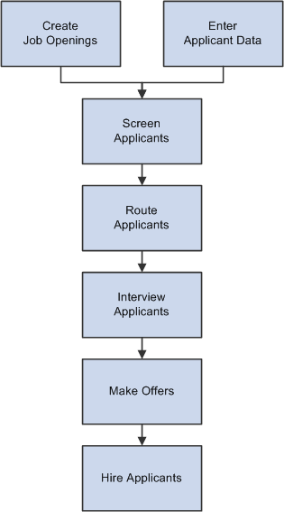
Background
Box laws do not:
  Preclude employers from ever inquiring about an applicant’s criminal history
    Postpones the inquiry until later in the hiring process. The rationale for doing this is to promote hiring based on qualifications, not criminal histories
  Require employers to hire people with criminal records
Dramatic increase in number of jurisdictions adopting these laws and more states and municipalities will likely pass "Ban the Box" laws.
Employers need to be ready to review and potentially revise their application process
Criminal history
background check
or inquiry

Slide 14
Statistics From NELP

Slide 15
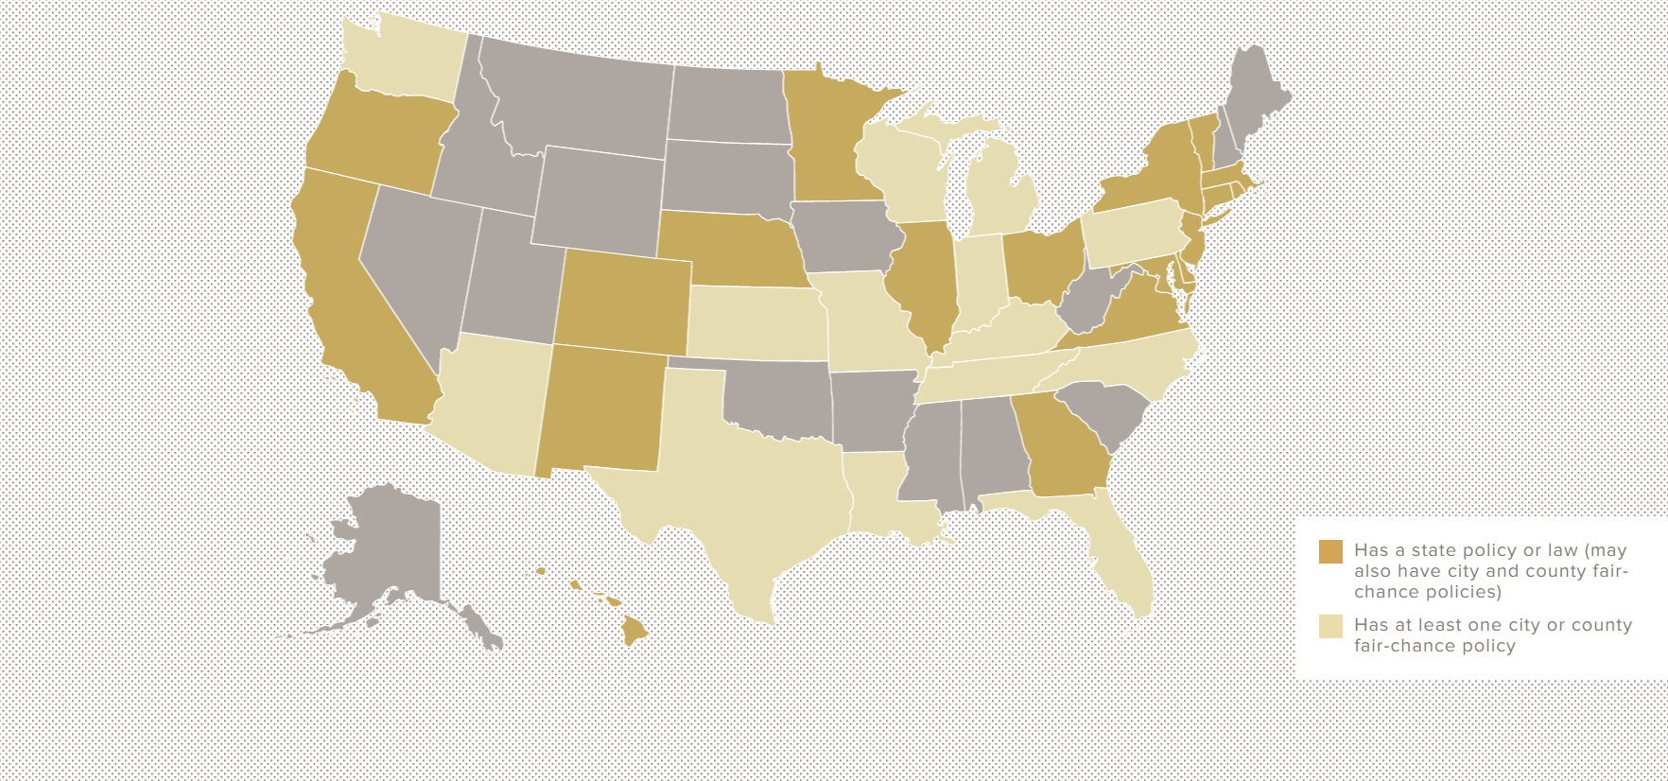
Where Are "Ban the Box" Laws Currently In Effect?
California, Colorado, Connecticut, Delaware, District of Columbia, Georgia, Hawaii, Illinois, Maryland, Massachusetts, Minnesota, Nebraska, New Jersey, New Mexico, New York, Oregon, Rhode Island, Vermont, and Virginia.

Slide 16
Where Are "Ban the Box" Laws Currently In Effect?
The District of Columbia, Hawaii, Illinois, Massachusetts, Minnesota, New Jersey, and Rhode Island have "Ban the Box" laws that apply to private employers.

Slide 17
Where Are "Ban the Box" Laws Currently In Effect?
Cities and counties have been especially prolific in passing "Ban the Box" laws. More than 100 localities across the United States have some form of "Ban the Box" law.
Of these, more than ten cities and counties (New York City, Baltimore, Buffalo, Chicago, Columbia (MO), Montgomery County (MD), Newark, Philadelphia, Prince George’s County (MD), Rochester, and San Francisco) have "Ban the Box" laws that apply to private employers.

Slide 18

Executive Order Extends "Ban the Box" Protection to Applicants for Federal Employment
In November 2015, President Obama instructed the Office of Personnel Management (OPM) to remove inquiries about criminal records from federal employment applications.
This initiative is part of continued efforts toward criminal justice reform.
The President also announced grants to help communities provide resources to the ex-incarcerated, including:
    Job training
    Child care resources.
In addition the President asked congress to pass reforms that would not only "ban the box," but also eliminate mandatory minimum sentences for nonviolent offenders.

Slide 19
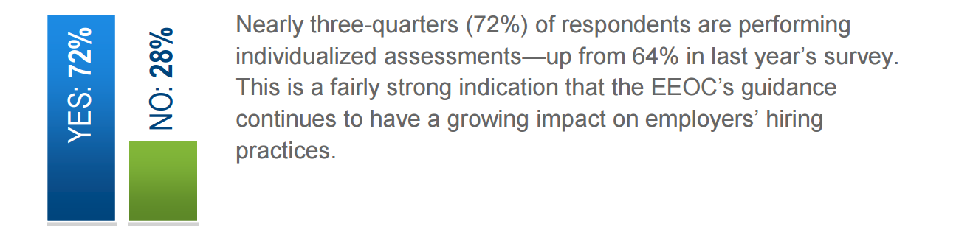
Employee Screen IQ: Applicants Get a Chance to Explain
2015 Employment Screening Survey
“Does your company perform individualized assessments for candidates
with convictions so they can explain the circumstances?”
Reference: http://www.employeescreen.com/university/expert-articles

Slide 20
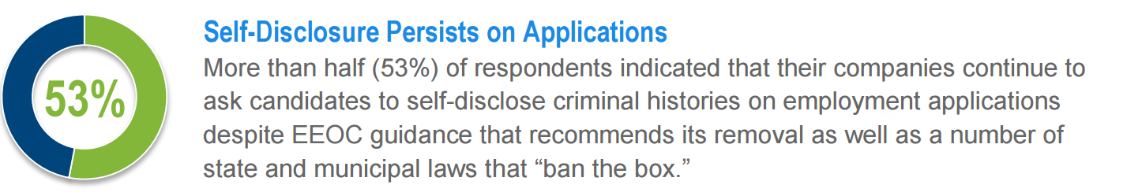
Employee Screen IQ: Applicants Get a Chance to Explain
2015 Employment Screening Survey
Reference: http://www.employeescreen.com/university/expert-articles

Slide 21

EEOC v. BMW, No. 7:13-cv-01583 D.S.C.
Consent decree (9/8/15):
Ordered BMW to pay $1.6 million and provide job opportunities to alleged victims of race discrimination as part of the resolution of a lawsuit filed by the EEOC alleging that BMW excluded African-American logistics applicants who BMW's contractor re-workers from employment at a disproportionate rate when the company's new logistics contractor applied BMW's criminal conviction records guidelines to incumbent logistics employees.
BMW will offer employment opportunities to the discharged workers in the suit and up to 90 African-American fused to hire based on BMW's previous conviction records guidelines. BMW also will provide training on using criminal history screening in a manner consistent with Title VII.
Reference: http://www.eeoc.gov/eeoc/newsroom/release/9-8-15.cfm

Slide 22



The Fair Credit Reporting Act
Requires employers to provide applicants with notice of adverse actions and to give them a notice, but it does not do much more to protect applicants
FCRA does not
  Prevent employers from not hiring someone because he or she has a criminal record
  Apply to consumer reports not prepared by consumer reporting agencies
  Govern how employers should consider criminal history information
Many states’ Ban the Box laws address one or more of these topics and include supplemental Fair Credit Reporting Act provisions.

Slide 23

FCRA Litigation and Settlements
Whole Foods Market Group Inc. agreed to pay nearly $803,000 to settle a class action lawsuit alleging violations of the FCRA for improperly disclosing to job applicants that they would undergo background checks.
Background checks are subject to strict disclosure and authorization requirements under the FCRA and the lawsuit claimed that the Whole Food application process “violated the FCRA due to the inclusion of a liability waiver in its FCRA disclosure”.

Slide 24

FCRA Litigation and Settlements
Chuck E. Cheese paid $1.75 million to settle a class action lawsuit that claimed restaurants failed to provide job applicants with proper background check disclosures.
As part of the class action lawsuit settlement, Chuck E. Cheese – also known as CEC Entertainment Inc. – agreed to change job applications used by the company to better comply with FCRA requirements governing the use of background check disclosure forms.

Slide 25

FCRA Litigation and Settlements
Home Depot paid 1.8M in connection with class action that claimed the company violated the FCRA by not having the proper forms for job applicants to fill out in order to conduct background checks on them.
The class action lawsuit claimed Home Depot “violated the FCRA by including releases of liability in their preauthorization background and/or credit check disclosure forms.”

Slide 26

FCRA Litigation and Settlements
Food Lion, LLC and its parent company Delhaize America, LLC reached a $3 million settlement in a class action lawsuit filed by a group of job applicants over allegedly illegal background checks in violation of the FCRA.
The class action lawsuit claimed Delhaize violated the FCRA requirement for “a clear and conspicuous disclosure” or “stand-alone disclosure” when a background check report is “obtained for employment purposes.”

Slide 27

FCRA Litigation and Settlements
Pitt v. K-Mart Corp.,
Plaintiff’s October 2011 class action complaint alleged that K-Mart willfully violated the FCRA prior to obtaining consumer reports and prior to taking adverse actions against the class.
In January 2013, parties reached a $3 million settlement, which received final approval from the court on May 24, 2013.

Slide 28

FCRA Litigation and Settlement
Plaintiffs in class action alleged that the consent form Domino’s used for procuring a consumer report violated the FCRA and that Domino’s took adverse actions against applicants without providing the required notices prior to the adverse action being taken.
Under the terms of the settlement, Domino’s agreed to pay to $2.5 million to a settlement fund, from which plaintiffs’ counsel’s 25% fee award would be taken.

Slide 29

FCRA Litigation and Settlement
Plaintiff alleged that, after applying with U.S. Xpress, defendant did not ask him if the company could obtain a consumer report as part of the application process, that defendant’s decision not to hire plaintiff was based, in part, on erroneous information in the report, and that plaintiff did not receive notice until after the decision was made
Defendant settled the class action lawsuit for $2.75 million.

Slide 30

Recent FCRA Litigation and Settlement
Plaintiff accused two CRAs of providing inaccurate criminal background reports to employers that caused the class of applicants to suffer adverse actions, and of not notifying them at the time defendants provided the consumer reports to prospective employers.
The case settled on November 12, 2013, when defendants agreed to pay $18.6 million to settle the FCRA claims.

Slide 31
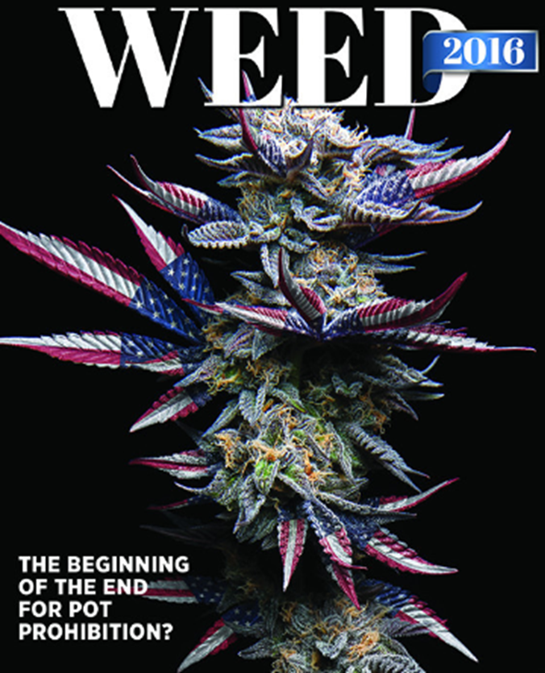


Attitudes Toward Marijuana Have Changed

Slide 32

The History of U.S. Marijuana Policy
Marijuana Tax Act of 1937
  Backed by Special Interests
  Opposed by the American Medical Association
1960’s
  Drugs & Free Love = Hippies = Bad
1970 Controlled Substance Act (“CSA”)
  Schedule 1 Drugs: Have no accepted medical use, have a lack of accepted safety for use under medical supervision and have a high potential for abuse.
  Examples: Heroin, LSD, Ecstasy and Marijuana

Slide 33

Legalization of Recreational Marijuana
In 1995, California Passes Proposition 215
  California becomes the first state in the country to pass legislation legalizing marijuana for medical purposes.
A number of states follow suit and legalize the use of medicinal marijuana.

Slide 34
Legalization of Medical Marijuana
To date, 28 States and Washington D.C., Guam, and Puerto Rico
Have Legalized Medicinal Marijuana
Alaska
Arizona
Arkansas
California
Colorado
Connecticut
Delaware
Florida
Guam
Hawaii
Illinois
Maine
Maryland
Massachusetts
Michigan
Minnesota
Montana
Nevada
New Hampshire
New Jersey
New Mexico
New York
North Dakota
Ohio
Oregon
Pennsylvania
Puerto Rico
Rhode Island
Vermont
Washington
Washington D.C
Notes:
Today, we have 28 states, Washington D.C., Guam, and Puerto Rico that have all legalized medicinal marijuana.

Slide 35

Legalization of Recreational Marijuana
Eight States and Washington D.C. Have Legalized Recreational Marijuana…Including Four In the Last Election
Alaska
California
Colorado
Oregon
Maine Vermont (Pending)
Massachusetts
Nevada
Washington
Washington D.C.

Slide 36
Prop 215 in California (1995)
In 1995, California Passes Proposition 215
  California becomes the first state in the country to pass legislation legalizing marijuana for medical purposes.
A number of states follow suit and legalize the use of medicinal marijuana.

Slide 37

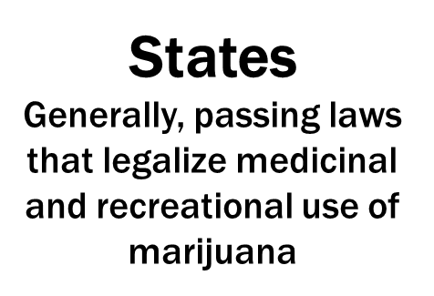
Where Do We Stand Today?
Federal Law
Marijuana is still
considered a
Schedule I drug

Slide 38
Enforcement
2009 – The “Ogden Memo” – DOJ urges federal prosecutors to stop prosecutions of medical marijuana distributors that are otherwise lawful under state laws
  http://www.justice.gov/sites/default/files/oip/legacy/2014/07/23/dag-guidance-2011-for-medical-marijuana-use.pdf
U.S. Attorneys should not “focus federal resources in [their] States on individuals whose actions are in clear and unambiguous compliance with existing state laws providing for the medical use of marijuana.”
Ogden went on to say that patients and caregivers in particular should not be targeted, though “commercial enterprises” were still an enforcement priority
Notes:
Even though the clear and unambiguous language in the Controlled Substances Act deems marijuana a Schedule I drug, in the 8 years, we have seen a major shift in attitude towards marijuana use and at least – in practice – a move towards decriminalization of certain marijuana users.
First, in 2009, President Obama good on his campaign promise to refocus federal drug enforcement efforts away from marijuana use and in October 2009 -- Deputy Attorney General David Ogden from the Department of Justice released what has become known as the "Ogden memo" -- a memorandum advising federal prosecutors that their efforts on “significant” drug traffickers and that the disruption of drug manufacturing were the “core” priorities and U.S. attorneys should not “focus federal resources in [their] States on individuals whose actions are in clear and unambiguous compliance with existing state laws providing for the medical use of marijuana.”
Ogden went on to say that patients and caregivers in particular should not be targeted, though “commercial enterprises” were still an enforcement priority.
This marked a significant shift in federal policy towards marijuana use and more of a “hands off” approach to those states who had begun setting up laws and regulations permitting lawful use and possession of marijuana – for medicinal reasons as well as for recreational uses as well.

Slide 39
Enforcement
The “Cole Memos” – issued by new Deputy AG James Cole in June 2011 and August 2013
June 2011 memo – backpedaled some and warned that “the Ogden Memorandum was never intended to shield such activities from federal enforcement action and prosecution, even where those activities purport to comply with state law.”
  http://www.justice.gov/sites/default/files/oip/legacy/2014/07/23/dag-guidance-2011-for-medical-marijuana-use.pdf
August 2013 memo – outlined DOJ eight enforcement priorities and stated that “the existence of a strong and effective state regulatory system, and an operation’s compliance with such a system, may allay the threat [to federal enforcement priorities].”
  http://www.justice.gov/iso/opa/resources/3052013829132756857467.pdf
Notes:
Since 2009 – we have seen a number of other federal guidance memos and congressional and regulatory actions suggesting the federal government has significantly softened its stance on marijuana use.
“Cole memos” issued by Deputy Attorney General James Cole in June 2011 and August 2013
Cole’s first memo in 2011 backpedaled on the Ogden memo’s position, noting an “increase in the scope of commercial cultivation, sale, distribution and use of marijuana for purported medical purposes” and warning that “the Ogden Memorandum was never intended to shield such activities from federal enforcement action and prosecution, even where those activities purport to comply with state law.”
However in August 2013 – AFTER voters in Colorado and Washington approved the recreational use of marijuana – the DOJ offered new guidance which outlined DOJ’s eight enforcement priorities (basically, a no-no list for those trying to operate legitimate marijuana businesses).
The DOJ went so far as to concede that “[o]utside of these enforcement priorities, the federal government has traditionally relied on states and local law enforcement agencies to address marijuana activity through enforcement of their own narcotics laws” and “the existence of a strong and effective state regulatory system, and an operation’s compliance with such a system, may allay the threat [to federal enforcement priorities].”
Eight enforcement priorities (**translated – if activities are legal under state laws and didn’t run afoul of these federal priorities, DOJ would not come after you)
Preventing the distribution of marijuana to minors
Preventing revenue from the sale of marijuana from going to criminal enterprises
Preventing the diversion of marijuana from states which have legalized its use to those which have not
Preventing marijuana transactions from being used as cover or pretext for other illegal activities
Preventing violence and the use of firearms in cultivation and distribution
Preventing drugged driving and other adverse public health consequences
Preventing cultivation on public lands and the attendant public safety and environmental concerns
Preventing marijuana possession or use on federal property

Slide 40
Recent Developments
December 2014 – “Wilkenson Memo” – extends Cole memo to marijuana activities on tribal lands.
  http://www.justice.gov/sites/default/files/tribal/pages/attachments/2014/12/11/policystatementregardingmarijuanaissuesinindiancountry2.pdf
December 2014 – Congress defunds DEA’s budget to carry out raids on medicinal marijuana businesses operating legally under state laws.
December 2015 – DEA recommends to FDA that they reclassify marijuana from schedule 1 to schedule 2 drug under Controlled Substances Act.
November 2016 – Election Day
Notes:
In December 2014, the DOJ issued a memorandum from Monty Wilkinson, Director of the Executive Office for U.S. Attorneys, extending the Cole Memorandum policy to marijuana activities on tribal lands. The 2014 Indian Country Memorandum directs U.S. Attorneys to use the Cole Memorandum priorities as a guide when enforcing federal law on Indian tribal areas. DOJ is less likely to prosecute on tribal lands when those activities are authorized by a strong and effective tribal regulatory system – similar to deference given to states when strong regulatory system in place.
Pinoleville Pomo Nation plans to break ground on a $10 million, 100,000-square-foot marijuana greenhouse just outside of Ukiah, Calif. The project will be the first of its kind on tribal lands in California and comes on the heels of the DOJ’s widely reported memorandum regarding the cultivation, sale, possession, and use of marijuana on tribal lands.
December 2014 – Congress passes federal spending bill, which contains protections for medical marijuana and industrial hemp operations in states where they are legal. The spending bill includes an amendment that prohibits the Department of Justice from using funds to go after state-legal medical cannabis programs that are otherwise complying with state laws and regulations where medicinal marijuana is legal.
December 2015 – DEA recommends to FDA that they reclassify marijuana from schedule 1 to schedule 2 drug under Controlled Substances Act. Rescheduling marijuana would not make it legal, but a lower schedule could potentially not only ease restrictions on research into the drug and make banks less wary of offering financial services to state-legal marijuana businesses: It would also provide further assurances to those either using, possessing, or operating marijuana based businesses in states where it is legal that the DOJ will not come knocking on their door – and possibly a change to whether marijuana is criminalized at all under the CSA in the years to come.
November 2016 – On Election Day, 4 states voted to legalize the use of recreational marijuana (, you may also recall that we also elected a new President.

Slide 41

What Will Trump Do?

Slide 42
Trump and Marijuana Legalization
Trump – Legalizing marijuana for anything other than medicinal use is a “bad” experiment and called Colorado’s legal marijuana industry “a real problem.”
Sean Spicer – “There are two distinct issues here: medical marijuana and recreational marijuana.”
Spicer said the Department of Justice will consider "greater enforcement" of federal marijuana laws, even in states that have legalized the drug.
Notes:
It’s not clear where President Trump stands.
Trump has publicly stated his support for medical marijuana and states' rights to regulate it, but Trump has called legalizing marijuana for anything other than medicinal use a “bad” experiment. However, he has also said it’s a matter for the states. To date, his administration as yet to take a definitive stance.
Sean Spicer has also drawn the distinction between medicinal marijuana and recreational marijuana. He said in interviews that: “There are two distinct issues here: medical marijuana and recreational marijuana…there’s still a federal law that we need to abide by when it comes to recreational marijuana and other drugs of that nature.”
Spicer also commented that he expects the Justice Department to increase enforcement of laws prohibiting the recreational use of marijuana, a departure from the Obama administration’s less aggressive stance as states began legalizing recreational as well as medical use of the drug.
That said, there were a number of states considering marijuana laws in 2016 that went RED for Trump – including Arizona, Arkansas, Florida, Montana and North Dakota.
Additionally, there is a federal bill pending, H.R. 975, the “Respect State Marijuana Laws Act of 2017,” in the U.S. House of Representatives. The bill would amend the Controlled Substances Act by adding language that its provisions do not apply to a person acting in compliance with state marijuana law. It has yet to be seen whether that will pass or what support it will muster given the other priorities in Congress.

Slide 43

Attorney General Jeff Sessions
Sessions has historically opposed marijuana legalization
Oversees the DEA and other federal law enforcement operations
Mach 2017 – Mass. Treasurer Deborah Goldberg sought clarity from Sessions regarding whether the DOJ plans to implement changes regarding federal marijuana policy, e.g. crack down on states that have legalized marijuana.
Notes:
We do know where Attorney General Jeff Sessions stands with respect to legal marijuana, but we don’t know yet what he will DO.
He has a long history of vocal opposition to marijuana legalization.
Sessions said in an April Senate hearing on marijuana reform that "good people don't smoke marijuana." The senator also pointed to the theory that marijuana is a gateway drug, and said that, "you'll see cocaine and heroin increase more than it would have.“
As Attorney General, Sessions would oversee the DEA and other federal law enforcement operations so he has the power to impact .
Sessions, however, also has a long history of support for state’s rights issues.
Marijuana is now legal at some level in states that (combined) are roughly ~60 percent of the U.S. population. It is possible that he may temper his opposition and allow states that have legalized it to continue to operate.
In March, Massachusetts Treasurer Deborah Goldberg sought clarity from Attorney General Jeff Sessions regarding whether the DOJ plans to implement changes regarding federal marijuana policy, e.g. crack down on states that have legalized marijuana.
SO – may be a distinction between the treatment of medical marijuana and recreational marijuana

Slide 44

What Do Employers Need to Know?
General Rule – employers in all 50 states and the District of Columbia can regulate an employee’s use of marijuana by:
  Prohibiting marijuana possession and use at work
  Prohibiting employees from reporting to work impaired or under the influence of marijuana
Notes:
We have talked about the landscape of laws regulating recreational marijuana and current enforcement policy.
Now, as an employer, what do we know?
There are various federal laws dealing with dealing with criminalization and states laws permitting use of marijuana for either medicinal purposes or in at least 8 states and Washington DC for recreational purposes – and you may be thinking --- “My company regularly drug tests and maintains a zero tolerance policy for drugs in the workplace – why did I need to care about ANY of this??”
And you would in PART be right – yes – there are absolutely NO federal or state laws preventing employers from prohibiting marijuana possession and use at work or prohibiting employees from reporting to work impaired or under the influence of marijuana.
[There are a number of ADA implications and FMLA implications, which we can cover towards the end of the session and in the written materials.]

Slide 45
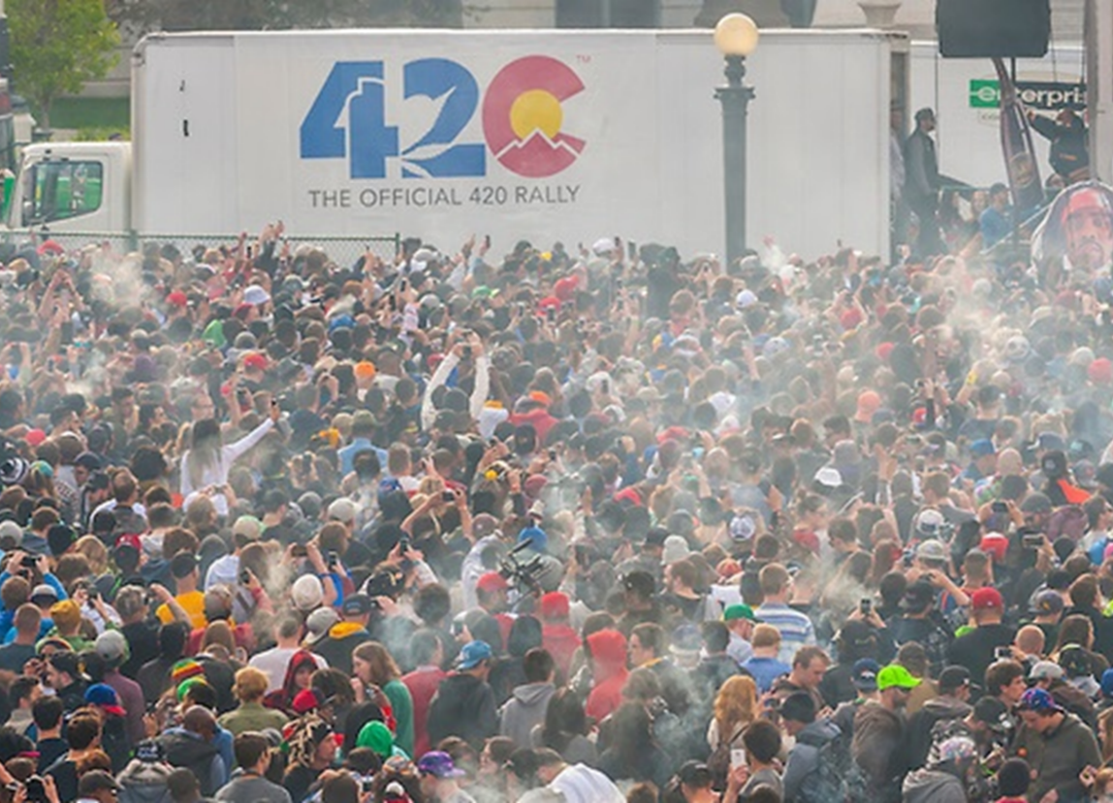
But…
Nearly $5 billion dollar and growing marijuana industry
1.8 million LEGAL marijuana users
Shifting norms and perceptions towards use of marijuana for recreational and/or therapeutic reasons
Notes:
But with nearly 5 billion dollar and growing marijuana industry, 1.8 million LEGAL marijuana users, and shifting norms and perceptions towards use of marijuana for therapeutic or recreational reasons – employers will inevitably have to deal with this issue in their workplace (to the extent they have not already) and need to mindful of the legal landmines that are out there.

Slide 46

Best Practices
Treat marijuana use similarly to alcohol
Prohibit employees from reporting to work or working while "under the influence of alcohol and/or other drugs that adversely affect the employee's ability to safely perform his or her job duties."
Include information regarding what your approach to drug and alcohol testing will be.
Notes:
If an employer does not have federal contracts and resides within a state that has legalized the use of marijuana, the development of a policy is within its discretion.
May want to consider adopting a policy that permits the use of marijuana, but treats it in the same fashion as alcohol.
Policy should prohibit employees from reporting to work or working while "under the influence of alcohol and/or other drugs that adversely affect the employee's ability to safely perform his or her job duties.“
Clearly articulate what your company’s approach to drug and alcohol testing will be.

Slide 47
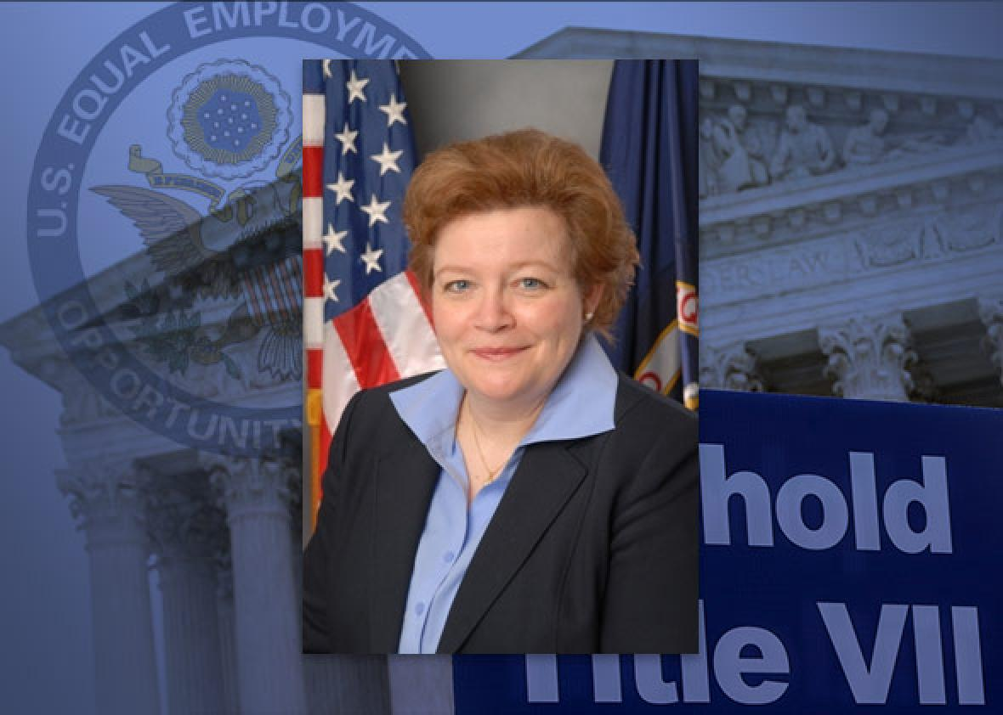
Rise in Pay Equity Laws
EEOC’s equal pay data rule faces hostility from Trump administration and acting chair Victoria Lipnic
Increasing popularity at state level: In 2016, pay equity laws took effect in CA, MD, and NY, and another was passed in MA

Slide 48

Parental Leave Regulations
Number of states requiring employers to offer paid leave for certain events (e.g., baby bonding) is expected to grow
  CA, NJ, and RI already offer paid family leave
  NY’s law will take effect in 2018, and DC has approved very expansive law (8 weeks of paid leave post-birth / adoption)
Possibility of action at federal level?

Slide 49
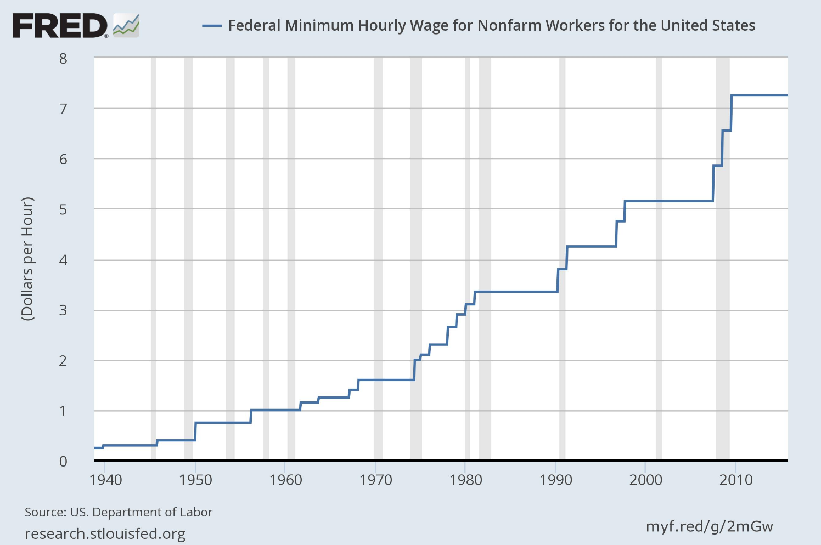
Minimum Wage Changes
Federal minimum wage unlikely to change (set at $7.25)
Several states and localities considering minimum wage increases, including IL (from $8.25 to $15)
  Two other high-population states, CA and NY, raised their minimum wages to $15 in 2016

Slide 50

Growing Interest in Predictable Scheduling
Several states are seeking to limit “just-in-time” or “on-call” scheduling practices for retail and food service employees
  San Francisco enacted first such measure in US, followed by Seattle
  In March 2017, NYC introduced a pair of initiatives

Slide 51

Thank you!
Barbara L. Johnson, Esq. May 11, 2017

