Slide 1
What It Means to Be “Trauma-Informed”:
Best Practices In Title IX Investigations and Hearings
The Consortium For Title IX and Equality in Higher Education
Spring Conference
James C. Dockery, JD
Assistant VP Institutional Equity & Compliance
www.utdallas.edu/titleix
Developed by Brandy Davis, JD
Director of Title IX Initiatives

Slide 2
Why “Trauma-Informed”?
To avoid re-traumatizing victims and perpetuating a hostile environment
Better investigations
  AND OF COURSE…
Because OCR says so
  See, e.g., OCR’s Questions and Answers about Title IX and Sexual Violence (April 14, 2014), University of Virginia Resolution Agreement, OCR Docket No. 11-11-6001 (Sep. 17, 2015)

Slide 3

What is Trauma?
Psychological trauma is the unique individual experience of an event or enduring conditions, in which:
  The individual’s ability to integrate his/her emotional experience is overwhelmed, or
  The individual experiences (subjectively) a threat to life, bodily integrity, or sanity
Esther Giller, Sidran Institute. What is Psychological Trauma? (1999) https://www.sidran.org/resources/for-survivors-and-loved-ones/what-is-psychological-trauma/

Slide 4

What is Trauma? Contd.
“[T]rauma is defined by the experience of the survivor. Two people could undergo the same noxious event and one person might be traumatized while the other person remained relatively unscathed.” - Esther Giller

Slide 5
Who Should be Trauma-Informed?
Title IX Coordinator
Campus “communicators” and first responders
  “Any school officials responsible for discussing safety and confidentiality with students should be trained on the effects of trauma and the appropriate methods to communicate with students subjected to sexual violence.” (2011 OCR Q&A, E-2)
Investigator(s)
Campus law enforcement
Legal counsel
Hearing/appeals officers and panels—anyone involved in grievance process
Service providers such as counselors and other healthcare professionals
Other employees and faculty
Students

Slide 6
The Impact of Trauma
Factors That Tend to Increase Traumatic Impact of Event
  Severity
  If it is interpersonal (as opposed to noninterpersonal, such as accidents and natural disasters)
    Interpersonal traumas may impact victim’s views regarding safety, intimacy, and trustworthiness of others
  When it is chronic or repeated
    Persistent traumas may leave the survivor feeling overwhelmed, helpless, and with a sense that the trauma is inescapable
      (Wamser-Nannay and Vandenberg, 2013)

Slide 7

Sexual Violence By the Numbers
44% percent of reported sexual assaults take place before the victim is 18. One in three-to-four girls, and one in five-to-seven boys are sexually abused prior to leaving high school.
Females ages 16-19 are 4 times more likely than the general population to be victims of rape, attempted rape, or sexual assault.
Women ages 18-24 who are college students are 3 times more likely than women in general to experience sexual violence. Females of the same age who are not enrolled in college are 4 times more likely.
  1 out of every 10 rape victims are male.
  21% of TGQN (transgender, genderqueer, nonconforming) college students have been sexually assaulted, compared to 18% of non-TGQN females, and 4% of non-TGQN males.
(rainn.org)

Slide 8

Counterintuitive Victim Behavior
Why didn’t she scream?
Why didn’t she try to run away?
Why didn’t he fight back?
How can it be rape if she didn’t say “no”?

Slide 9

Response During an Assault
Fight, Flight, Or Freeze
When a person is under stress, a cocktail of stress chemicals are released:
Catecholamines: Fight or flight response
  includes epinephrine (adrenaline), norepinephrine (noradrenaline), and dopamine
Cortisol: Makes energy available
Opioids: Prevents pain
Oxytocin: Promotes good feelings

Slide 10
Fight or Flight
Increased heart rate & blood pressure, hyper ventilation, glucose to major muscles
Digestive and immune systems shutdown to conserve energy for fight or flight
Rational thought impaired (e.g., may not realize the door is open or that someone in the next room would hear if she screamed)
Sensory details, especially olfactory, more prominent
Focus on “survival” rather than remembering “what happened”
Opioids released have a numbing, spacey effect

Slide 11
Freeze
Sometimes a victim’s body shuts down (freezes) – tonic immobility
“Deer in headlights”
Parasympathetic nervous system is activated
  “Playing dead” (aka “collapsed immobility”)
  Unable to speak
  Muscles relax
  Endorphins released to numb pain, decrease panic, and increase chances of survival
  Orientation towards fear with no outward sign of stress; glazed look but conscious
  Numbness
  Sense of heaviness
  Feeling stuck in some part of the body
  Dissociated from emotions, rational thought is decreased

Slide 12
Why Would the Body Freeze?
“Research studies with animals have documented that sometimes the best way to protect the body is to freeze, to play dead, fighting back or fleeing would only prolong the threat and endanger the body even worse (maybe even risk death). In other words, sometimes the safest solution isn't fight-or-flight. The safest option is to freeze and so the brain and body work together to hold the organism still until the threat has passed.”
- Dr. Rebecca Campbell, professor of community psychology at Michigan State University
Fight, flight, or freeze = three normal, biological responses to threatening encounters
These responses are autonomic, which means they happen automatically without conscious thought or decision making

Slide 13

Tonic Immobility
12-50% rape victims experience tonic immobility during assault, and most data suggests that the rate is actually closer to the 50 percent than the 12 percent
TI appears to be more common in victims who have been assaulted before (childhood, adolescence, or adult)
Associated with increased self-blame
Associated with decreased likelihood of seeking help
Response of friends, family, service providers can be hurtful due to lack of understanding (“Why didn’t you fight?”)

Slide 14
Behavior During Interviews and Hearings
Some victims’ behavior during interviews or hearings may appear odd. Remember that they may continue to be affected by the “chemical cocktail” associated with trauma when recalling a traumatic event
Various “normal” responses include:
  Emotional, crying, hysterical
  Flat affect – seeming numb
  Laughing, light-heartedness, inappropriate
  Cycling of emotions

Slide 15

Trauma and Memory
She can’t get her story straight…
How could she not remember something as significant as that?
He is obviously making it up as he goes along…

Slide 16

Trauma and Memory
Explicit Memory: can be consciously and intentionally recalled
  Facts, general knowledge, autobiographical (placing self in space & time)
Implicit Memory: Remember unconsciously and effortlessly
  Emotional responses, body sensations, reflexive actions

Slide 17

Trauma and Memory
Under extreme stress, the initial sorting of explicit and implicit layers continues, but processing is interrupted

Slide 18

Trauma and Memory
Memories of a Traumatic Event:
Stored in amygdala (“implicit”)
Non-linear recall of events
Poor recall of contextual information (like the layout of a room)
Details are fuzzy
Focus may be on what someone did to survive event; what are perceived as important details to victim may seem odd to investigator
Memories of a Non-Traumatic Event:
Stored in hippocampus (“explicit”)
Linear recall of events
Specific details
“Significant details” make sense to investigator

Slide 19
Trauma and Memory
The hippocampus may go into a “super encoding” state briefly after the fear kicks in:
  Victims may remember in exquisite detail what was happening just before and after they realized they were being attacked, including context and the sequence of events
  They are likely to have very fragmented and incomplete memories for much of what happens after that
Rationale: “If an animal is to survive, it’s most important to remember what predicted an attack, not exactly what happened after the attack was underway.”
The brain is flooded with stress chemicals and storing predictive information, and it cannot absorb much new information
(Hopper 2016)

Slide 20
Long-Term Effects of Trauma
94% of women who are raped experience post-traumatic stress disorder (PTSD) symptoms during the two weeks following the rape.
30% of women report PTSD symptoms 9 months after the rape.
33% of women who are raped contemplate suicide.
13% of women who are raped attempt suicide.
Approximately 70% of rape or sexual assault victims experience moderate to severe distress, a larger percentage than for any other violent crime.
38% of victims of sexual violence experience work or school problems, which can include significant problems with a boss, coworker, or peer.
(rainn.org)

Slide 21
Long-Term Effects
Even years later, traumatized people often have enormous difficulty telling other people what has happened to them. Their bodies re experience terror, rage, and helplessness, as well as the impulse to fight or flee, but these feelings are almost impossible to articulate. Trauma by nature drives us to the edge of comprehension, cutting us off from language based on common experience or imaginable past.
-- Bessel A. Van der Kolk, The Body Keeps Score (2014)

Slide 22
PTSD
Posttraumatic stress disorder (PTSD) is a psychiatric disorder that can occur in people who have experienced or witnessed a traumatic event. Symptoms of PTSD fall into four categories and vary in severity:
  Intrusive thoughts such as repeated, involuntary memories; distressing dreams; or flashbacks of the traumatic event. Flashbacks may be so vivid that people feel they are re-living the traumatic experience or seeing it before their eyes.
  Avoiding reminders of the traumatic event may include avoiding people, places, activities, objects and situations that bring on distressing memories. People may try to avoid remembering or thinking about the traumatic event. They may resist talking about what happened or how they feel about it.

Slide 23
PTSD Contd.
  Negative thoughts and feelings may include ongoing and distorted beliefs about oneself or others (e.g., “I am bad,” “No one can be trusted”); ongoing fear, horror, anger, guilt or shame; much less interest in activities previously enjoyed; or feeling detached or estranged from others.
  Arousal and reactive symptoms may include being irritable and having angry outbursts; behaving recklessly or in a self-destructive way; being easily startled; or having problems concentrating or sleeping.
Many people who are exposed to a traumatic event experience symptoms like those described above in the days following the event.
For a person with PTSD, symptoms last for at least a month and often persist for months and sometimes years.
(American Psychiatry Association, “What is PTSD?” 2014)

Slide 24
Secondary Traumatization
Secondary victimization refers to behaviors and attitudes of social service providers that are "victim-blaming" and insensitive, and which traumatize victims of violence who are being served by these agencies.
Institutional practices and values that place the needs of the organization above the needs of clients or patients are implicated in the problem:
  Failure to offer appropriate services and support
  Belief in rape myths that blame the victim for the assault
  Provision of services in a way that damages the victim’s wellbeing
  (Campbell 1999)

Slide 25

When to Conduct An Initial Interview
There is evidence that waiting two days (two full sleep cycles) to conduct the interview of a victim may result in more coherent, detailed information because the brain will have had a chance to recover and consolidate memories during that period
(Campbell 2012)

Slide 26

Trauma-Informed Interview Tips
Think about presentation and atmosphere. Be mindful of first impressions (in writing, on the phone, or in person).
  Where is the interview taking place? Consider privacy, light, noise, accessibility, etc.
  How do you present yourself?

Slide 27
Trauma-Informed Interview Tips
To the extent possible, help the complainant feel empowered in the process. Emphasize choices and give the complainant a sense of control whenever possible:
  Whether to file a formal complaint
  Whether to pursue a police report
  Whether to begin the interview at initial meeting, or have preliminary “informational meeting” first
  When to take breaks
BUT...be honest about the extent to which they are NOT in control in the process (e.g., circumstances in which the college would move forward against their wishes)

Slide 28
Trauma-Informed Interview Tips
  Start the interview by having the complainant tell their “story,” in their own words, with minimal interruptions necessary, before asking follow-up questions. Ask open-ended questions whenever possible. Save the technical questions for the end (“Can we go back to…”).
  Provide sufficiently detailed information and a clear explanation of your role as investigator (or other role) and the investigation process. Provide information in writing and go over it again in person (do this for both parties).
  Think ahead regarding basic information so they don’t have to ask (but encourage questions)
  Avoid jargon and acronyms
  Explain evidence standard and what the “findings” will mean

Slide 29
Trauma-Informed Interview Tips
  Try to use the interviewee’s words back to him or her, but clarify meaning of slang (“He told me to give him a BJ”) and vague phrases (“She touched my my private area”).
  Don’t let YOUR discomfort take you out of the moment. The investigator MUST be able to talk about “blow jobs” and “BDSM” without reacting with shock or judgment.
  Think before you speak. Avoid questions or comments that may appear to victim-blame. Be strategic and purposeful with regard to word choice and tone. Be mindful of body language.
  Is the question relevant? (“What were you wearing?”)
  Is the question clear?
  “Help me understand…”

Slide 30
Trauma-Informed Interview Tips
Maintain appropriate boundaries for your role, but try to build a connection. Limited small talk is okay (with both parties). Getting to know a little about the parties helps build rapport and may also help your investigation.
Don’t rush. Give time to process. If you sense that he or she is getting tired or irritated, take a break or quit for the day.
Keep the parties updated the status of the investigation (timeline, next steps, etc.).
Share information between investigators or co-interview (including with law enforcement) when possible to avoid having the complainant tell his or her story again and again.

Slide 31
Trauma-Informed Adjudication
University of Virginia – OCR found (among other things):
  The University did not make arrangements so that the complainant and respondent didn’t have to be in the same room at the same time (the policy said such options were available at the sole discretion of the hearing panel chair)
  The University used a mediation-like process for informal resolution of sexual assault – the complainant sat down with the respondent in front of Dean of Students/hearing panel chair to discuss his or her feelings about alleged incident and its impact
The resolution agreement required training on the “potential impact of trauma on the behavior of victims of sexual harassment or sexual violence, including how it may impact participation in the investigative process and the hearing by the Review Panel.” (U. Va. Resolution Agreement, Sept. 17 2015).

Slide 32
Do’s and Don’ts – Trauma-Informed Hearings
Do not allow parties to cross-examine each other.
“OCR strongly discourages a school from allowing the parties to personally question or cross-examine each other during a hearing on alleged sexual violence. Allowing an alleged perpetrator to question a complainant directly may be traumatic or intimidating, and may perpetuate a hostile environment. A school may choose, instead, to allow the parties to submit questions to a trained third party ( e.g. , the hearing panel) to ask the questions on their behalf. OCR recommends that the third party screen the questions submitted by the parties and only ask those it deems appropriate and relevant to the case.” (2014 OCR Q&A, F-6).
Do not offer informal resolution methods, such as mediation, in cases involving violence (even if voluntary; even if requested by the complainant).

Slide 33
Do’s and Don’ts – Trauma-Informed Hearings
Do not allow inappropriate questions or information to be presented.
  “Questioning about the complainant’s sexual history with anyone other than the alleged perpetrator should not be permitted. Further, a school should recognize that the mere fact of a current or previous consensual dating or sexual relationship between the two parties does not itself imply consent or preclude a finding of sexual violence. The school should also ensure that hearings are conducted in a manner that does not inflict additional trauma on the complainant.” (2014 OCR Q&A, F-7).
  No “Why are you such a slut?” Questions

Slide 34

Do’s and Don’ts – Trauma-Informed Hearings
Do provide options for the parties’ participation in the hearing: strategic seating arrangements, closed-­circuit testimony, telephone testimony, Skype, using a room divider or separate hearing rooms.
Do ensure the parties know what to expect during the hearing.

Slide 35
References
Giller E. What is psychological trauma? Sidran Institute website. https://www.sidran.org/resources/for-survivors-and-loved-ones/what-is-psychological-trauma. May 1999.
Wamser-nanney R, Vandenberg BR. Empirical support for the definition of a complex trauma event in children and adolescents. J Trauma Stress. 2013;26(6):671-8.
Campbell R. Lecture presented: The Neurobiology of Trauma at Michigan State University; December 3 2012. (available at https://www.nij.gov/multimedia/presenter/presenter-campbell/pages/presenter-campbell-transcript.aspx)
Hopper, Jim. The impact of trauma on brain, experience, behavior, and memory. http://www.jimhopper.com/pdf/handout_for_interviewers.pdf.
American Psychiatric Association. What is PTSD? https://psychiatry.org/patients-families/ptsd/what-is-ptsd. July 2015.
Campbell R. and Raja S. Secondary victimization of rape victims: insights from mental health professionals who treat survivors of violence. Violence and Victims, V. 14 (3), 1999. (available at https://mainweb-v.musc.edu/vawprevention/research/victimrape.shtml)
Campbell R. Talking about tonic immobility on tonight’s SVU. http://www.joyfulheartfoundation.org/blog/talking-about-tonic-immobility-tonights-svu Oct. 10, 2012.

Slide 36
Ensuring Fairness in Trauma-Informed Title IX/Clery Act Investigations
May, 2017
Jeffrey J. Nolan, J.D.
Dinse, Knapp & McAndrew, P.C.

Slide 37
Legal Environment as of May 9, 2017
April, 2011 Office of Civil Rights (“OCR”) Dear Colleague Letter (“DCL”); http://www2.ed.gov/about/offices/list/ocr/letters/colleague-201104.pdf
April, 2014 OCR Questions and Answers; http://www2.ed.gov/about/offices/list/ocr/docs/qa-201404-title-ix.pdf
2014 VAWA Amendments to Clery Act
October, 2014 VAWA/Clery regulations
  Incorporate several “equal treatment of parties” concepts found in DCL

Slide 38
OCR Guidance
Dear Colleague Letters are subject to change from one administration to another
Trump administration recently withdrew 2016 DCL on transgender students
Institutions should stay up to speed on current developments, and recognize that OCR guidance and perspectives is subject to change

Slide 39
Clery Act Procedural Requirements
Final Clery regulations which require that parties will have equal rights include, e.g.:
  to present witnesses and other evidence
  to have similar access to information that will be used at the hearing
  to attend pre-hearing meeting
  to have “advisor of choice” (including legal counsel) present during interviews and any meetings
© Jeffrey J. Nolan, 2016

Slide 40
OCR Procedural Issues Not Addressed in Clery Regulations
Clery requires institutions to state what standard of proof they are using, but does not mandate a preponderance standard
Clery does not prohibit direct cross-examination of complainants

Slide 41
Recent Pertinent Case Law

Slide 42
Respondent Claims
Recent years have shown substantial increase in number of cases, with significant developments in related case law
“Reverse Title IX” claims are surviving motions to dismiss more often (but not always)
Student Handbook/contract, tort, implied covenant claims are common as well
Constitutional due process claims common at public institutions

Slide 43
Illustrative Cases

Slide 44
Trauma-Informed, Fair Investigations and Adjudications

Slide 45
Importance of Process
Primary goal of investigations and adjudications is to determine in good faith what happened, under applicable burden of proof
Investigations and adjudications should follow good practices and be defensible, because:
  First and foremost, institutions want to be fair and accurate in their decisions; and
  Investigations and adjudications will be scrutinized when a complainant or respondent is dissatisfied with result
© Jeffrey J. Nolan, 2016

Slide 46
Ensuring Fairness to All Parties
Information about the potential effects of trauma, possible “counterintuitive” complainant behavior, and evidence of potential trauma must be viewed in the context of institutional disciplinary proceedings, in which:
  Individual cases must be judged on their own merits
  Decision in every case must be based on evidence presented, weighed under applicable standard of proof
  Cannot fill in evidentiary gaps with statistics, personal beliefs, or research findings
  Process must be fair and impartial to each party

Slide 47
Implications for College and University Proceedings
There are no bright-line rules
Withhold pre-judgment: The parties may not act consistently with stereotypes
Be aware of your own biases as well as those of the complainant, respondent and witnesses
Understanding the potential effects of trauma can fairly “level the playing field”

Slide 48
Implications for University Proceedings
Victim-blaming, relying on stereotypes, assuming that “real victims” cry, struggle, report immediately, cut off all contact, etc., can result in inaccurate, flawed investigations and adjudications
Trauma-related memory problems and “counterintuitive” behaviors do not necessarily establish that policy was not violated
However, presence of those problems or behaviors, or evidence of possible trauma, do not necessarily establish that policy was violated

Slide 49
Interview Considerations
Understand rationale for considering evidence of, e.g.:
  Motivations, choices, clothes
  Use of drugs/alcohol
  Inconsistencies
The point: you are not victim blaming; you are considering necessary details without pre-judgment
© Jeffrey J. Nolan, 2016

Slide 50
Interview Considerations
Focus on What Can be Remembered
Memories related to senses of smell (particularly), hearing, touch, taste, sight may be better formed due to effects of trauma on memory
Experience, thought process during event
If fear motivated acquiescence without consent, specifically why afraid?
Recollection of details may improve over time and in follow-up interviews
© Jeffrey J. Nolan, 2016

Slide 51
Interview Considerations
A FETI-influenced approach, e.g.:
  “What are you able to tell me about your experience . . . ?”
  “What more are you able to tell me about that?”
  “Can you help me understand . . . ?”
Can be used at the outset of interviews of both parties
Can fairly use similar approach to inquire about experience of each party, then interview for clarification as necessary

Slide 52
Fairness in Investigations
None of these good practices necessarily disadvantage or prejudice respondents
Asking “what are you able to tell me about,” listening patiently, and following up sensitively and without judgment, does not prejudice respondents so long as:
  You seek clarification of inconsistencies to extent possible, and
  Your decision is based on the most relevant, available facts, weighed under the applicable standard of proof

Slide 53
Summary
A trauma-informed approach should encourage reporting and complainant participation
Employed properly, a trauma-informed approach does not “favor” complainants or disadvantage respondents
A trauma-informed approach recognizes and accounts for societal and personal biases and “levels the playing field”, therefore fairly promoting accuracy
Accuracy and fairness is important to all parties and the institution

Slide 54
Questions?
Jeffrey J. Nolan, J.D.
Dinse, Knapp & McAndrew, P.C.
jnolan@dinse.com
(802) 864-5751
www.dinse.com

Slide 55


Investigation Techniques
Legal Requirements of Trauma-Informed
Sexual Assault Investigations
Barbara L. Johnson, Esq.
May 4, 2017

Slide 56



Duty to Investigate Under Title IX
“Once a [school] knows or reasonably should know of possible sexual harassment, it must take immediate and appropriate action to investigate or otherwise determine what occurred.
A [school] must take prompt and effective steps reasonably calculated to end the harassment, eliminate any hostile environment, prevent the harassment from recurring and, as appropriate, remedy its effects.
These duties are a [school’s] responsibility, regardless of whether a student has complained, asked the [school] to take action, or identified the harassment as a form of discrimination.”
  U. Va. Resolution Agreement, OCR Review No. 11-11-6001, Sept. 17, 2015

Slide 57
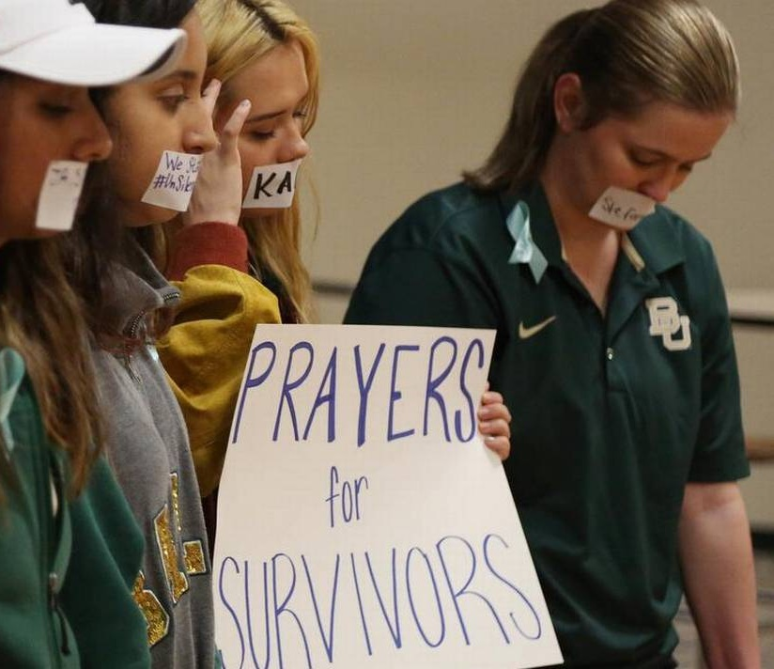
Duty to Investigate Under Title IX
On April 7, 2017, a Texas federal judge allowed a former Baylor University student to pursue her Title IX and negligence claims against school
The student, who was raped by a former Baylor linebacker in 2012, has argued the school’s conduct increased her risk of being assaulted
The lawsuit is one of several against Baylor regarding its failure to investigate and deal with sexual assault allegations on campus. According to the student, Baylor’s institutional indifference “subjected her to a heightened risk of sexual assault”

Slide 58

Duty to Investigate Under Title IX
“Baylor’s alleged failure to address and active concealment of sexual violence committed by its football players . . . was a form of discrimination. Baylor’s alleged knowledge of the need to supervise Elliot and protect female students plausibly constitutes deliberate indifference.
Finally, Baylor’s alleged indifference plausibly created an environment in which football players could sexually assault women, including Plaintiff, with impunity. That vulnerability—or heightened risk—plausibly constitutes harassment under Title IX.”
  Hernandez v. Baylor Univ., No. 6:16-CV-69-RP, 2017 U.S. Dist. LEXIS 54255, at *19-20 (Dist. Tex. Apr. 7, 2017).
Above: Arthur Ray Briles. He left Baylor in the wake of a major sexual assault scandal in his football program.

Slide 59

Investigation Must Consider Trauma
On top of a duty to investigate, schools must understand and anticipate issues surrounding trauma in fashioning their investigations into sexual assault and harassment allegations
Any school officials responsible for discussing safety and confidentiality with students should be trained on the effects of trauma and appropriate methods to communicate with victims of sexual violence and harassment
  See Q&A on Title IX and Sexual Assault, sect. E-2, OCR

Slide 60

Interviewing Complainants

Slide 61

Interviewing Complainants
First impression matters: can build complainant’s confidence in entire institutional response
However, trauma affects everyone differently
When should you conduct interview?
  Waiting two days may result in better recollection of events
Where should you conduct interview?
  In person v. over the phone? Level of privacy?
  Create a “safe zone,” a climate where complainant feels comfortable to report incidents

Slide 62

Interviewing Complainants
Introduce yourself, describe your role, and provide a clear and detailed overview of the investigation process
  Put complainant at ease while maintaining boundaries
Provide necessary information in writing prior to interview, and go over it again in person (do this for accused/respondent as well)
  Explain evidence standard but avoid overly technical terms
  Complainant has option to request the school maintain his or her confidentiality, which the school will consider
  You CANNOT guarantee confidentiality, though you can direct complainant to confidential resources

Slide 63

Interviewing Complainants
Have complainant recount what happened in their own words
  Recognize that complainant’s recollection may not be linear
Clarify ambiguous or unclear statements (“Help me understand…”)
Keep interruptions to a minimum
Complainant may need additional time to prepare themselves to discuss the events at issue (“Take all the time you need…”)
  Do not rush complainant; conduct interview at their pace
  HOWEVER, remember that timely collection of evidence in sexual assault investigations is critical (avoid undue delay)

Slide 64

Interviewing Complainants
Reassure and empower complainant throughout interview
  Wait for complainant to finish speaking before asking follow-up questions. Keep these questions simple and open-ended
  Explain your reasons for asking the questions
Victims of trauma often can recount vivid sensory details, so consider asking sensory questions (“What did you smell?”)
Create a dialogue: encourage complainant to ask questions
Be prepared to discuss uncomfortable or sensitive topics

Slide 65

Interviewing Complainants
Speak carefully and accurately
  Avoid words that imply consent or affection
  Avoid victim blaming (be compassionate and non-judgmental)
Inform complainant of their rights and care for their needs
  Give them a sense of control, such as their decision whether to file a formal complaint and/or police report
  BUT tell them about aspects of investigation beyond their control (e.g., you have an obligation to report names of parties involved in alleged sexual violence, as well as relevant facts related to incident, to school’s Title IX coordinator or other appropriate school officials)

Slide 66

Post-Interview Duties
If a complainant does not wish to file a criminal complaint or requests confidentiality, school still must launch an independent investigation and take immediate steps to protect complainant
  Take reasonable action in response to complainant’s information and “keep door open” for future, follow-up conversations
  Tell complainant you and the school will fully support them and protect them from retaliation and future harassment
  However, do not make promises or otherwise indicate you can or will satisfy complainant’s requests (“Accused must be expelled”)

Slide 67

Post-Interview Duties
Interim measures to protect complainant include:
  No-contact order
  Academic accommodations and support services
  Escort services
  Counseling and medical services
If school offers counseling as part of its Title IX obligation to take steps to protect complainant while investigation is ongoing, it must NOT require complainant to pay for this service

Slide 68

Post-Interview Duties
If complainant chooses not to pursue a formal investigation, school must weigh this request against seriousness of allegations and duty to protect students
  Interim measures not enough; must consider ”next steps” of investigation to remedy any hostile environment that may exist
To the extent possible, share information with other investigators, including with law enforcement officials
  Avoid having complainant recount their story multiple times

Slide 69

Post-Interview Duties
Integrate interview details into investigation report
  How did complainant describe experience (“out of body”?)
Inform all parties of timeline and status of investigation
  Grievance procedure must contain prompt timeframe of process
  Whether an investigation is “prompt” will vary, depending on complexity of investigation and severity of alleged conduct

Slide 70

Protect the Rights of Respondent

Slide 71

Protect the Rights of Respondent
When interviewing respondent, be fair and thorough in hearing their account and give them ample opportunity to respond to complainant’s allegations
Like with complainant, start with open-ended questions
  Avoid casting judgment or presuming guilt
To the extent necessary to conduct a fair investigation, notify respondent of complainant’s identity and account of events

Slide 72

Protect the Rights of Respondent
Critics claim OCR’s recent investigations and resolution agreements have incentivized schools to adopt policies that routinely violate the rights of students accused of sexual assault and harassment (who are overwhelmingly male)
  Many schools have replaced their pre-existing ”clear and convincing evidence” standard with OCR’s preferred “preponderance of the evidence” standard
Any investigation must be defensible in its treatment of both complainant and respondent (focus on “fairness”)

Slide 73

Protect the Rights of Respondent
”Brandeis appears to have substantially impaired, if not eliminated, an accused student’s right to a fair and impartial process. And it is not enough to say that such changes are appropriate because victims of sexual assault have not always achieved justice in the past.
Whether someone is a ‘victim’ is a conclusion to be reached at the end of a fair process, not an assumption to be made at the beginning. If a college student is to be marked for life as a sexual predator, it is reasonable to require that he be provided a fair opportunity to defend himself and an impartial arbiter to make that decision.”
  Doe v. Brandeis Univ., 177 F. Supp. 3d 561, 573 (D. Mass. 2016)

Slide 74

Protect the Rights of Respondent
“A covered university that adopts … a policy of bias favoring one sex over the other in a disciplinary dispute … to avoid liability or bad publicity, has practiced sex discrimination, notwithstanding that the motive for the discrimination did not come from ingrained or permanent bias against that particular sex.”
  Doe v. Columbia Univ., 831 F.3d 46, 58 n.11 (2d Cir. 2016)
Increasing success rate for accused students suing their schools on due process and gender bias grounds (with most students seeking expungement of their disciplinary records)

Slide 75

Protect the Rights of Respondent
In October 2016, OCR reached an agreement with Wesley College in Dover, Del. over allegations that the school violated Title IX rights of a student accused of sexual misconduct. (Wesley Resolution Agreement, OCR Review 03-15-2329, Oct. 12, 2016)
  Respondent alleged he was wrongly charged with sexual misconduct and expelled within seven days in April 2015
  OCR found respondent was denied key procedural protections: he was not provided a full opportunity to respond to the charges, rebut the allegations, or defend himself at his hearing

Slide 76
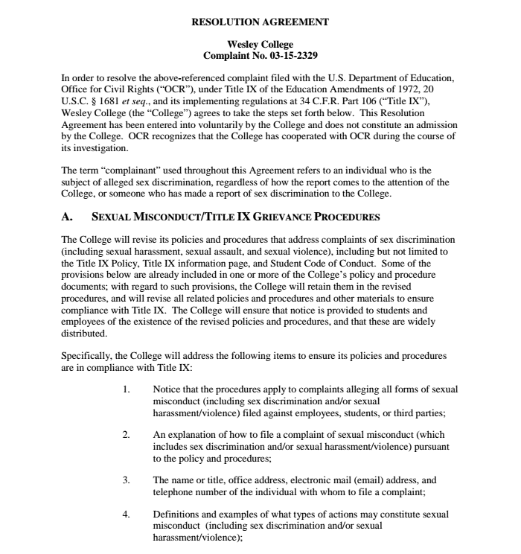
Protect the Rights of Respondent
According to OCR, Wesley’s violations included:
  Suspending respondent the same day it received report against him, even though it had not yet interviewed him
  Failing to interview respondent during investigation of complaint and providing him with incorrect policies and procedures
  Failing to give respondent access to info in report prior to hearing
  Precluding respondent from calling witnesses or offering other evidence at hearing

Slide 77
Trauma-Informed Investigations Are NOT
Inconsistent with Protecting Respondent Rights
Ten common allegations of investigational bias. See Victim-Centered Investigations: New Liability Risk for Colleges and Universities, Oct. 2016, http://www.saveservices.org/wp-content/uploads/Victim-Centered-Investigations-and-Liability-Risk.pdf
  Single-investigator approach (endorsed by White House in its Not Alone report, April 2014): investigator having multiple, conflicting roles and inadequate qualifications. OCR’s finding on Wesley College seems to question the legality of this approach
  No reasonable basis for initiating the investigation. Note, however, that OCR directs schools to endorse all allegations, regardless of merit
  Lack of proper notice, including delineation of charges, and improper preliminary actions
  Preventing respondent from contacting potential witnesses to testify on his/her behalf. Confidentiality policies should NOT preclude respondent from mounting a proper defense
  Incomplete or inadequate collection of evidence. These are among the most common allegations when respondents sue their schools, and a leading danger of victim-centered investigations (which afford “greater credibility to complainants’ statements”)

Slide 78
Trauma-Informed Investigations Are NOT
Inconsistent with Protecting Respondent Rights
Ten common respondent allegations of investigational bias. See Victim-Centered Investigations: New Liability Risk for Colleges and Universities, Oct. 2016, http://www.saveservices.org/wp-content/uploads/Victim-Centered-Investigations-and-Liability-Risk.pdf
  Flawed inferences from the evidence, or a failure to consider relevant evidence. Avoid confirmation biases and instead “follow the evidence”
  Failure to reconcile inconsistent accounts by complainant and witnesses (again, one of the dangers of the “always believe the victim” approach)
  Explicit bias or an intentional predetermination of respondents’ guilt. This is the category with the largest number of respondent allegations
  Undue investigational delays. OCR urges investigations be conducted within a period of days, not months (act to avoid spoliation of evidence)
  Improper record-keeping or reporting

Slide 79

Trauma-Informed Adjudication
Make sure the parties know what to expect going into the hearing (no surprises)
  Take steps to ensure the hearing does not inflict additional trauma on complainant
  Provide alternative options for participation, such as telephone or Skype interviews or using separate rooms

Slide 80
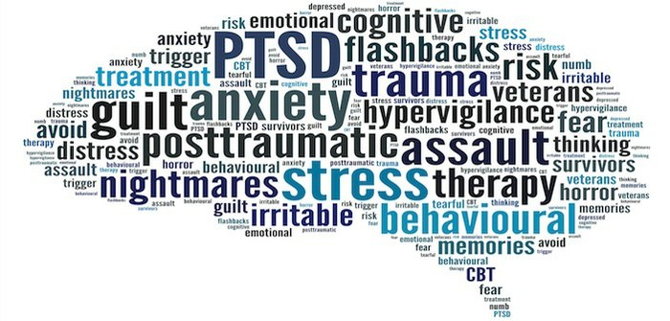
Trauma-Informed Adjudication
OCR made several, trauma-related findings about the University of Virginia’s pre-2015 policies (see U. Va. Resolution Agreement):
  Failed to make arrangements so that complainant and respondent did not have to be in same room at same time
  Used a mediation-like process to informally resolve sexual assault allegations: complainant (together with respondent) discussed the incident in front of the Dean of Students/hearing panel chair
Resolution agreement required training on potential impact of trauma on the behavior of sexual assault victims (i.e., must take trauma into account during investigation and adjudication)

Slide 81

Trauma-Informed Adjudication
OCR “strongly discourages” allowing parties to cross-examine each other; may be traumatic for complainant and perpetuate a hostile environment
  Instead, allow parties to submit appropriate and relevant questions to a trained third party to ask questions on their behalf
  DO NOT get into complainant’s prior sexual history except for their history with respondent (which does not itself imply consent or preclude a finding of intimidation or violence)
Also, in cases involving violence, do not offer informal resolution methods even if complainant requests that approach

Slide 82
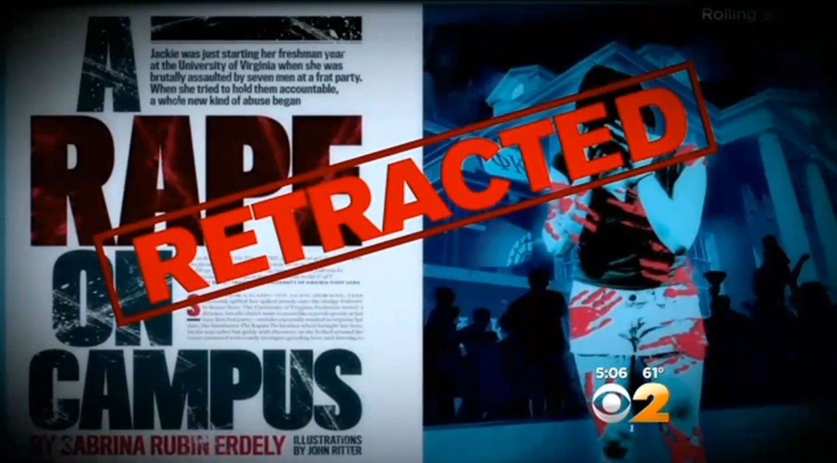
Final Thoughts
Countervailing Considerations:
  Responding promptly and seriously to all allegations of sexual assault and harassment
  Respecting the rights of both complainant and respondent at every stage of the investigation
Avoid knee-jerk reactions and a rush to judgment, especially if acting in response to criticism over previous investigations
  See, e.g., Rolling Stone being found liable for defamation for its discredited 2014 article detailing an alleged rape at the Univ. of Virginia. Former Associate Dean Nicole Eramo successfully sued the magazine in November 2016; the case settled in April 2017

Slide 83

Final Thoughts
Act quickly and purposefully in response to allegations
Be impartial, respectful, and thorough
Keep all parties well-informed of their rights and options, as well as the investigation’s progress
Maintain a transparent and clearly documented process (take copious notes throughout investigation)
DO NOT presume guilt or withhold information

