Slide 1
Utilizing PeopleSoft for Data Collection
Texas Christian University (TCU)
May 8, 2017

Slide 2
Benefits/Challenges for utilizing your internal system
Develop the program to meet your needs
Internal support and knowledge of your system
No additional time needed to interconnect two systems
NO outlay of monies
Constantly evolving as the laws change
TIME

Slide 3
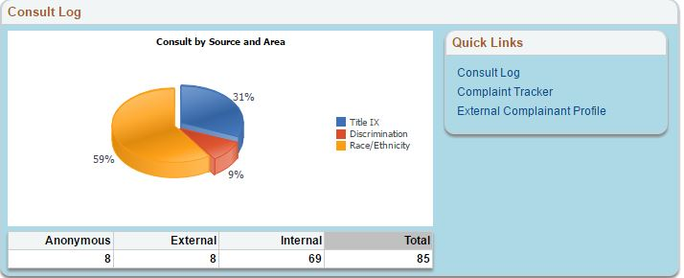
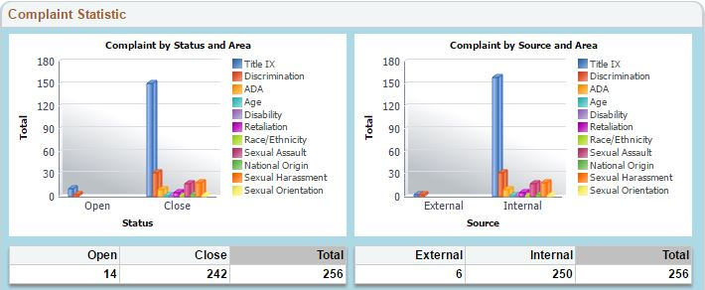
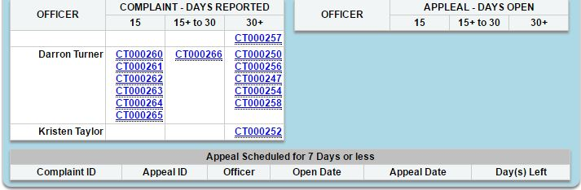
Compliance Complaint Tracker Summary

Slide 4
Tracker Section 1

Slide 5
Tracker Section 2

Slide 6
Tracker Section 3
https://

Slide 7
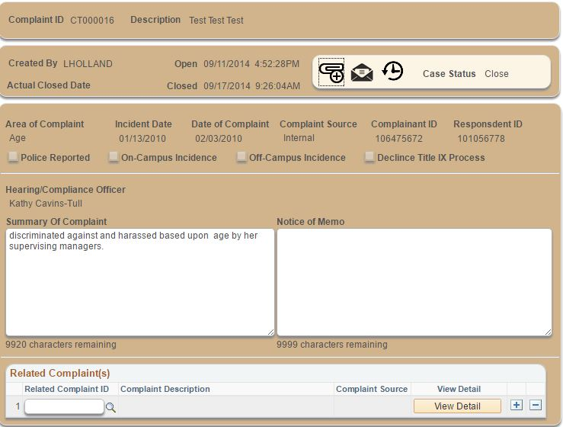
Complaint

Slide 8
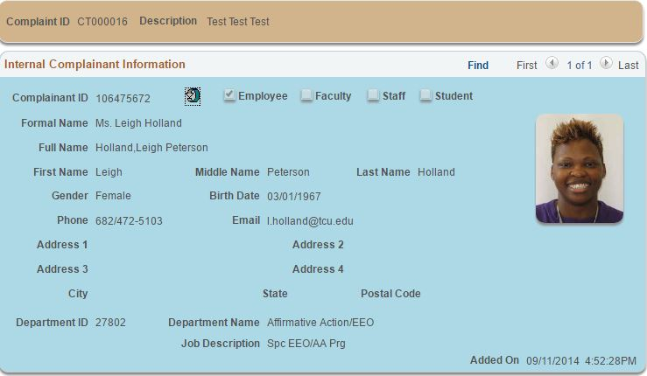
Complainant

Slide 9
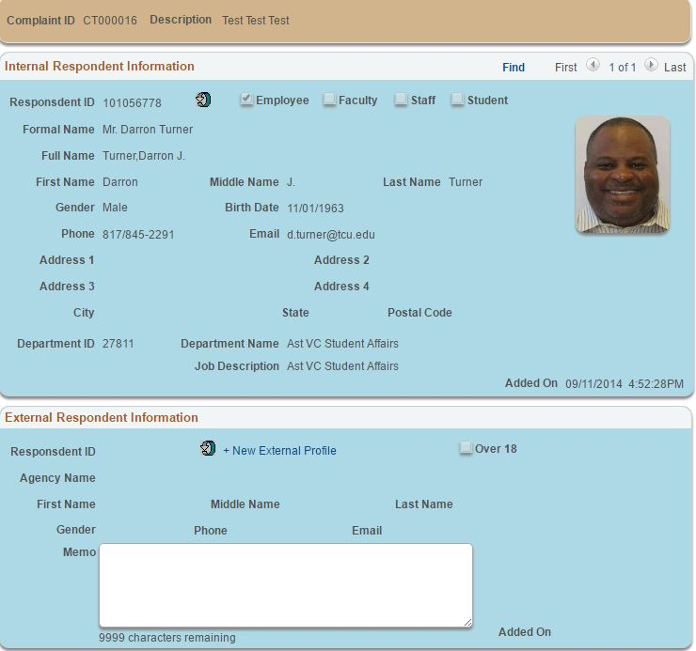
Respondent

Slide 10
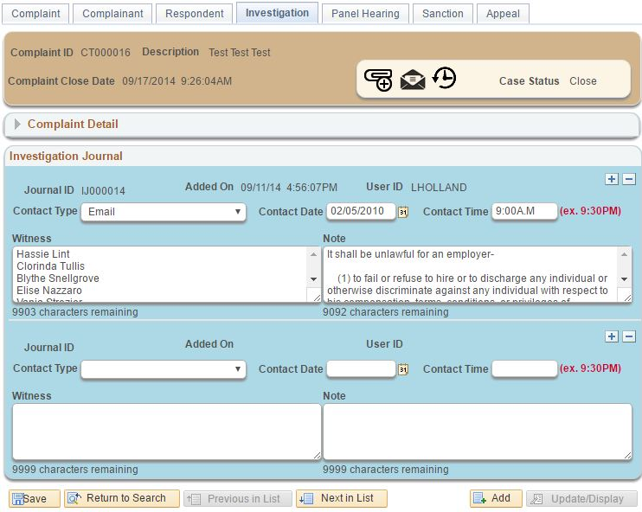
Investigation

Slide 11
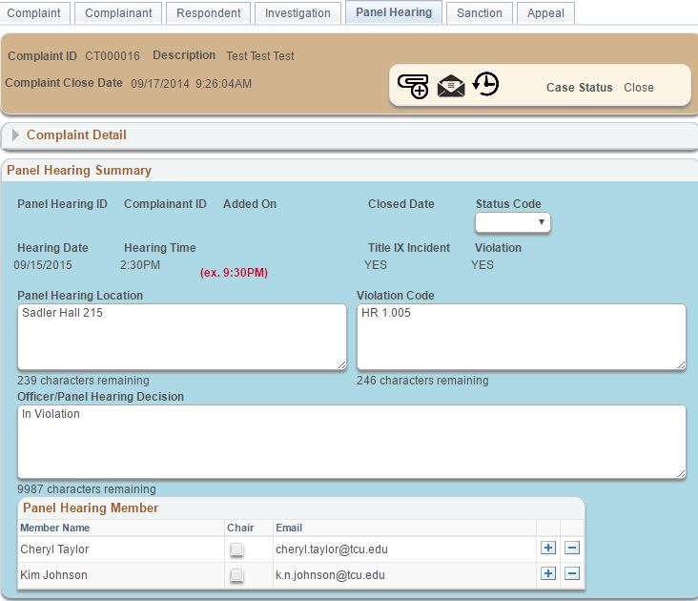
Panel
Hearing

Slide 12
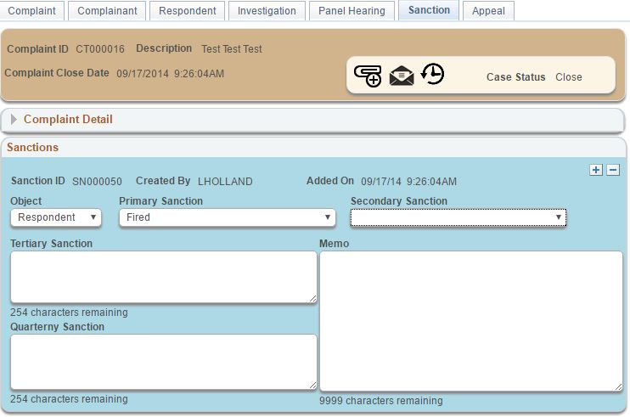
Sanctions

Slide 13
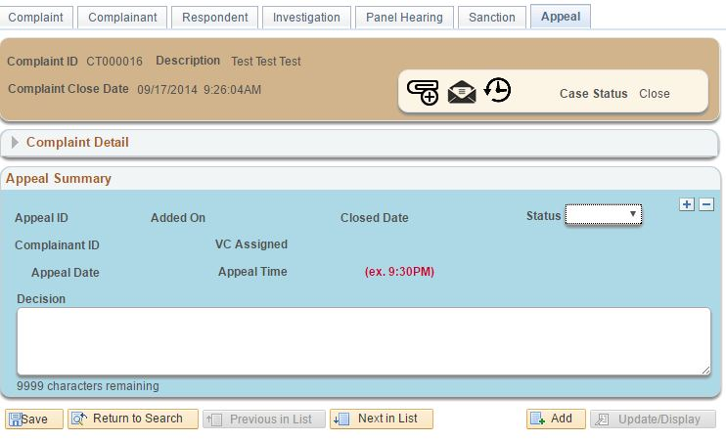
Appeal

