Slide 1
When Two Laws Collide:
Considerations in the Modern Political Age
Presented by:
Jeffrey Graves, Associate Vice President for Legal Affairs, Univ. of Texas at Austin
Tamra English, Senior Associate General Counsel and Managing Attorney, Univ. of Texas System
The Consortium of Title IX and Equity Officers in Higher Ed
May 2017

Slide 2
Overview
Recent Incidents on Campus
Legal Considerations
  The First Amendment
  Free Speech v. Hate Speech
When Two Laws Collide- Federal & State Laws v. The First Amendment
  Discrimination & Harassment
  Harassment and Academic Freedom
  Balancing Title IX and The First Amendment
  When Title IX and The First Amendment Collide
Practical Considerations
Discussion

Slide 3
Recent Incidents on Campus

Slide 4
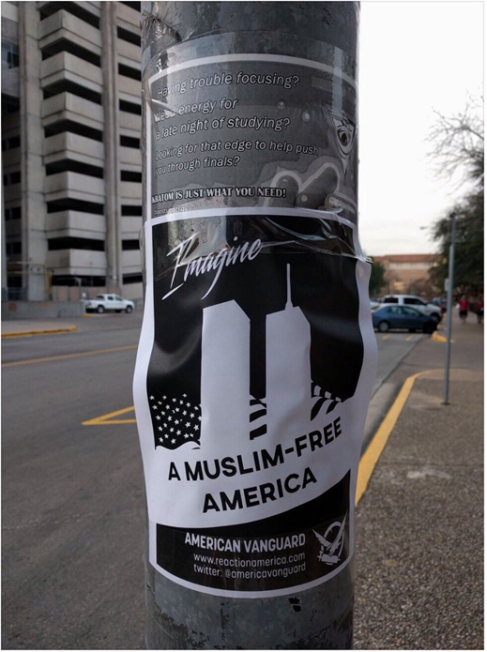
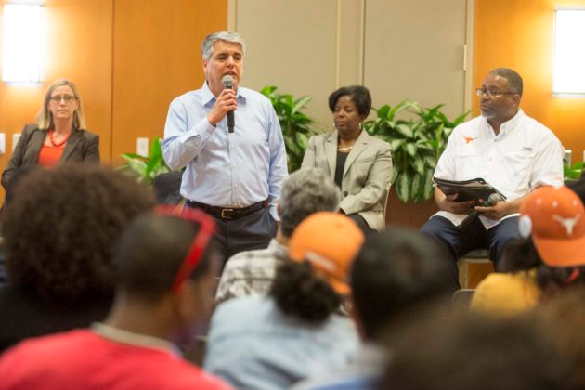
UT Austin
Campus Reaction:
  Anger
  Fear
  Outrage
  Voiced concerns at town hall forum
Administration Response:
  Town hall style forum
  Removal of posters
  Statement by University and comments on social media by UT Austin President

Slide 5
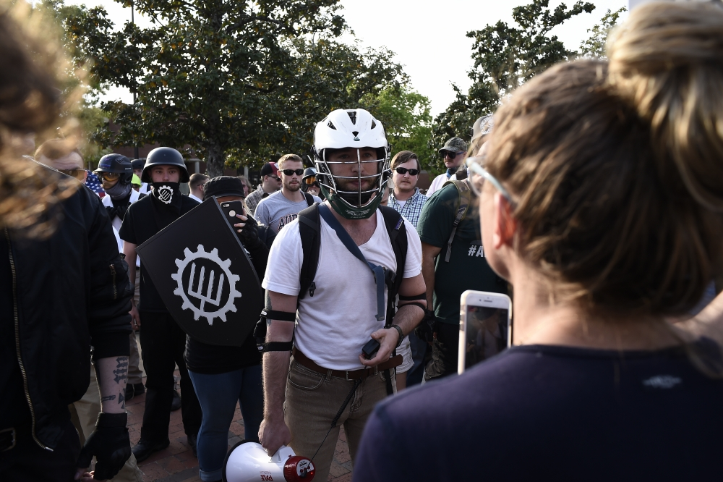

Auburn University
Campus Reaction:
  Protests
  Arrests
  Shouting down during the speech
  Organized concert before speech to counter Spencer’s hate speech
Administration Response:
  Canceled speech
  Forced to allow Spencer to speak by Court order
  Issued statement condoning Spencer’s views

Slide 6
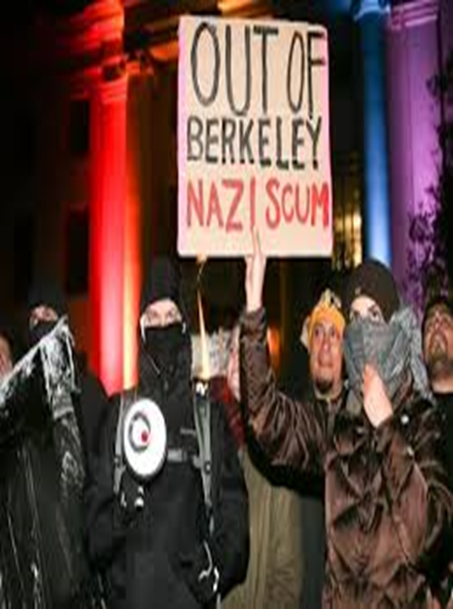

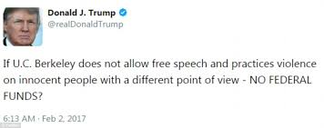
UC Berkeley
Campus Reaction:
  Riots
  Lighting Fires
  Hurling Rocks at Police
Administration Response:
  Condemned violence and unlawful behavior
  Prepared security measures
  Canceled appearance by Milo
  Statement by Chancellor

Slide 7
Legal Considerations

Slide 8
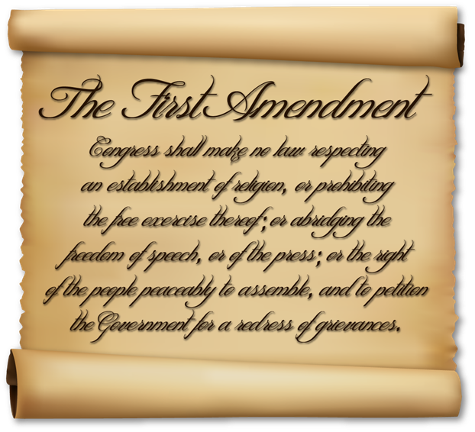
The First Amendment
“Congress shall make no law…abridging the freedom of speech.”

Slide 9

What Is Protected?
The First Amendment limits the government’s ability to restrict speech
Speech on a public campus is generally protected by the First Amendment.
Generally, speeches at a political protest rally on a campus are protected from discipline by public universities
For the most part, extremist groups may stand in public areas speaking hateful messages

Slide 10

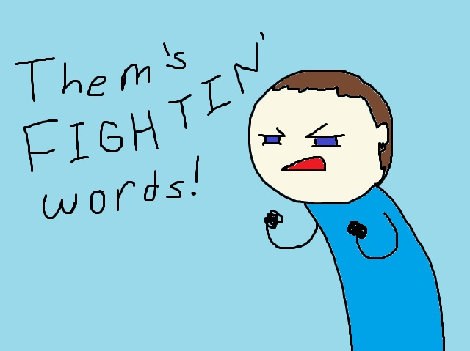

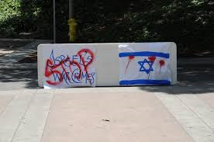
Speech That Is Not Protected
True threats
Inciting or Producing an Imminent Lawless Action
Fighting Words
Obscenity
Libel & Defamation
Discrimination/Harassment
Disruption

Slide 11


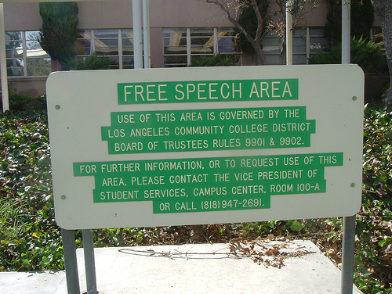
Time, Place and Manner
A public university is constitutionally permitted to place certain time, place and manner restrictions on speech
  Content neutral
  Narrowly tailored/government interest
  Ample alternative means of expression

Slide 12



Free Speech v. Hate Speech

Slide 13


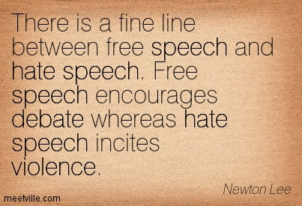
Freedom of speech is the right to articulate one's opinions and ideas without fear of government retaliation or censorship, or societal sanction.
Hate speech is speech which attacks a person or group on the basis of attributes such as gender, ethnic origin, religion, race, disability, or sexual orientation.

Slide 14
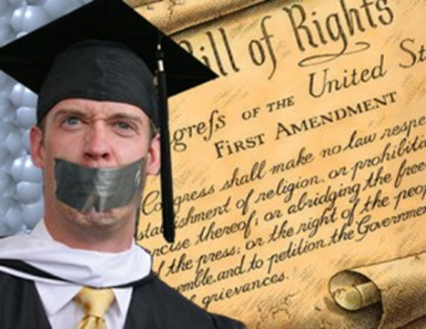
Campus Speech Codes
Balance between free speech, civility, respect & human dignity
Created to deal with hate speech
Based on “Fighting Words” Doctrine
Many held unconstitutional
  Overly broad and vague
  Regulation of content or viewpoint and not time, place and manner
Careful consideration in drafting

Slide 15
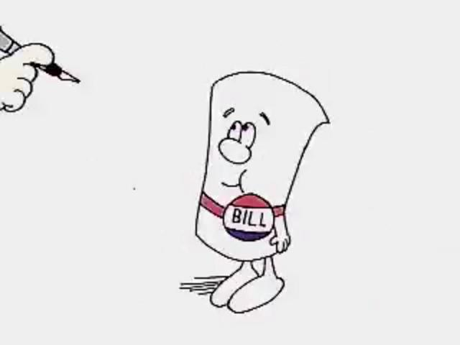
“MILO BILLS”
Legislation introduced in several states would restrict the ability of campuses to designate specific free speech zones or limit disciplinary action against students who engage in lawful expression no matter how offensive or immoral.
Would potentially extend responsibility to campuses to prevent students or members of the public from restricting free speech rights of other parties.
Texas Legislature – HB 2527& HB 1151

Slide 16
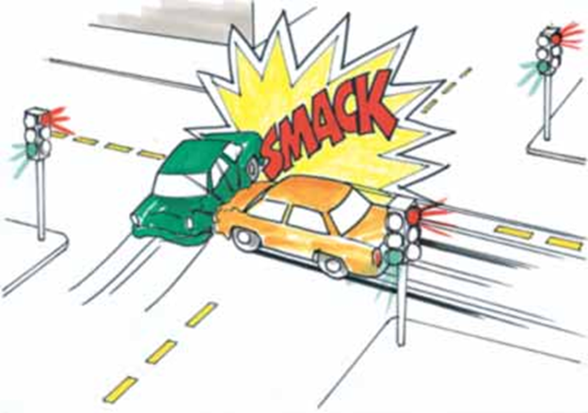
When Two Laws Collide

Slide 17

Federal & State Laws vs.
The First Amendment
Federal
  Title VI—race, color, national origin
  Title VII—race, color, national origin, religion, sex
  Title IX—sex (sexual orientation, gender identity, gender expression)
  ADA/Section 504—disability
  ADEA—age (over 40)
  State and Local Laws

Slide 18
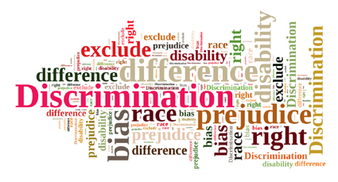
Discrimination & Harassment
OCR recognizes that “some conduct alleged to be harassment may implicate the First Amendment rights to free speech or expression.”

Slide 19
Possible Protected Categories
Race
Color
Ethnicity (Ethnic Origin)
National Origin (Ancestry)
Citizenship (Immigration Status)
Culture
Sex
Sexual Orientation
Gender
Gender Identity
Gender Expression
Pregnancy
Religion (Spiritual Beliefs)
Creed
Age (over 40)
Disability (Ability)
Marital Status
Family Relationship
Genetic Information
HIV Status
Socioeconomic Background
Public Assistance Status
Parental Status
Veteran (Military Status)
Smoker
Political Affiliation (Beliefs)
Social Affiliation
Shape/Size
Intellectual Perspective
Criminal Background
“Other Factors Irrelevant to Participation”

Slide 20
Harassment and Academic Freedom
Harassment in the Classroom by Faculty Members:
  In several instances, courts have struck down the use of anti-harassment policies to punish professors for classroom speech because the policies in question were impermissibly vague.
  Peer Harassment
  OCR has not carved out speech from its interpretation of Title IX and includes prohibitions on “verbal conduct.” This sets the stage for potential free speech conflicts.
    Faculty-to-faculty harassment: Some courts have held that faculty from public universities and colleges lack First Amendment Rights when speaking in their official capacities. Under that reading of Garcetti, if a faculty member engaged in verbal harassing conduct in his/her official capacity, the speech elements of that harassment would garner no First Amendment protections, and Title VI and IX would apply with full force.
    Student harassment: must consider additional factors such as Title IX requirements to take immediate action even when the student doesn’t want to report; compiling and reporting Clery statistics, etc.

Slide 21

Balancing Title IX and The First Amendment
OCR is charged with interpreting and enforcing Title IX
OCR states, “[T]he laws and regulations it enforces protect students from prohibited discrimination and do not restrict the exercise of any expressive activities or speech protected under the U.S. Constitution.”
Thus, when preventing discrimination, an institution must respect the free-speech rights of its community.

Slide 22
When Title IX and the First Amendment Collide
Confidentiality and reporting requirements of Title IX and the Clery Act implicate speech.
Class writing assignments: while OCR advises that a faculty member who learned of an incident via a required class writing assignment “would not be required to report the information to the Title IX coordinator or other appropriate designee,” the faculty member should provide that student information on Title IX, including information on how to file a complaint.
Social Media Concerns: in several cases, students have been disciplined for allegedly violating either the institution’s code of student conduct or the code of ethics of a professional program by the content of their social media postings.
Notes:
Bullet 1: The amendments and regulation emphasize maintaining the victim’s confidentiality, which imposes restrictions on what a school is permitted to say about incidents of sexual misconduct.
Bullet 3: See Tatro v. University of Minnesota (court rejected mortuary science student’s free speech claims after student posted statements on Facebook that were disrespectful to fellow students and donated cadaver and was disciplined); Snyder v. Millersville University (student was disciplined after she posted pictures of herself on MySpace drinking a beer; she was a student teacher at the time and had encouraged high school students to communicate through her MySpace account; court found that speech was not a matter of public concern and didn’t deserve 1st amendment protection); Yoder v. Univ. of Louisville (student dismissed from nursing program after posting unprofessional comments about live birth she witnessed; court found that university had legal and ethical obligations to ensure confidentiality of patients and policies preventing students from “blogging” about confidential matters were not overbroad).

Slide 23
Practical Considerations

Slide 24

Public Response to Incidents on Campus
Manage Expectations
Timely and strong reaction
Clear, unambiguous and public response
Release a statement condemning the act
Take steps to alert the campus
Detail how the situation will be handled
Do not remain silent

Slide 25
Review your Policies
Are your policies on-point?
Are they vague or do they narrowly define prohibited speech?
In FIRE’s 2015 review of 437 public and private schools, the organization determined that 241 school maintain at least one policy that “both clearly and substantially restricts freedom of speech, or that bars public access to speech-related policies.
While harassing speech can be abhorrent, “[t]here is no categorical ‘harassment exception’ to the First Amendment’s free speech clause.”

Slide 26

Questions?

Slide 27
This presentation is not intended to substitute for legal advice from your own campus counsel.

